Slide 1

Navigating AI: Theory of Change
Adam Leonard, Chief Analytics Officer
Texas Workforce Commission
LinkedIn.com/Adam-From-Texas

Slide 2
AI’s Transformation of the Labor Market
AI is likely going to change more jobs than any force in history
Salesforce found
  75% of GenAI users already use it for work
Boston Consulting Group found those using GPT-4
  Complete 12.2% more tasks, 25.1% more quickly, at 40% higher quality
  “Lower Performers” had greatest gains
Stanford/MIT study showed Tech Support Workers using AI Tools
  Resolved 14% more issues per hour (35% for Novice Workers)
LinkedIn found
  25% of members have seen Core Skills of jobs change since 2015 and GenAI estimated to increase that to 65% by 2030
  84% of members are in occupations where 25%+ of tasks can use GenAI
Notes:
https://economicgraph.linkedin.com/content/dam/me/economicgraph/en-us/PDF/future-of-work-report-ai-november-2023.pdf
https://economicgraph.linkedin.com/content/dam/me/economicgraph/en-us/PDF/preparing-the-workforce-for-generative-ai.pdf

Slide 3
Net Positive <> No Problems
General Consensus is Change in Jobs will be Net Positive or Zero?
  Doesn’t mean we won’t have impacted Workers
  Doesn’t mean Employers will have all the Jobs they need filled
Nov 2023 Survey found 44% expected AI-related Layoffs
  IBM expects 30% of HR/non-customer facing Roles to be replaced in a 5 year period (7800)
  Many Tech Employers laying off tens of thousands of workers even as they invest more in developing AI
Too much Improvement in Productivity in a Short Period is too Hard to Absorb
Notes:
44% figure from ResumeBuilder.com Survey
https://futurism.com/the-byte/ibm-replacing-humans-ai

Slide 4
Implications
“Innovation Breaks the Shackles of Scarcity”
AI’s ability to improve the Productivity & Quality of will reduce the value of Expertise
The half-life of education/training will continue to fall
Life-long learning will become essential to Self-Sufficiency & Economic Mobility

Slide 5
Traditional Education – Work Feedback Loop
Primarily SLDS: Longitudinal Employment/Earnings Outcomes
Huge lag in Traditional Feedback Loop:
  1-5 years measurement period +
  1-4 years to change a program
LM Demand will change faster than the LM Supply Pipeline can change using that Feedback Loop
We need a shorter Feedback Loop

Slide 6
Solution is Shift to a Skills Based Ecosystem
First Signals of Change are not found in Employment & Earnings Levels
First Signals of Change are found in SKILLS on Job Postings
  Not in Occupational Titles and Credentials
Skills focus also Critical to helping existing Workers transition to new jobs & Employer find new Workers
LinkedIn found 75% of their Postings “Required” a 4 Year Degree
  This locks out 79% of Rural, 79% of Hispanic, & 72% of Black Workers
Matching Based on Skills increases Qualified Applicant Pools Substantially (11-56%)
  Increased qualified women applicants in historically under-represented fields by 26%

Slide 7
Building a Skills-Based Ecosystem
Job Posting Data provides a near-time signal of changes in Employer Demand
  That data will reveal shift the mix of Skills in demand & emergence of new ones
Solution:
  AI identifies changing demand for and emerging Skills in Postings
  Adoption of Skills Taxonomies that package this information which is communicated to Education & Training Providers
  Courses change in Months instead of Programs/Credentials in Years
  Programs/Credentials need to be mapped to Skills
  Students need to understand & communicate the Skills they are gaining
Skills-Focused Labor Market will promote Resiliency & Mobility as jobs change at speed and in volume never before seen

Slide 8
NLx Pilot & Other Efforts
TWC is working with GWU to extract skills data from NLx
Longitudinal Skills Data will be used to generate Tools that
  Track changes over time
  Identify emerging Skills
  Create projections of skills demand
There are other efforts to develop new, high value datasets
  Credential Engine wants to map Skills to Credentials using Job Postings
  Several States are working on enriching wage data with Skills Data

Slide 9



NLx Pilot – Basic Workflow
3.
Analysis
Perform analytical modelling on extracted skills and produce actionable results.
Skills Extraction
Isolate and classify key tokens from job description into skills.
2.
Pull from datahub and perform preprocessing on the raw data set.
1.

Slide 10
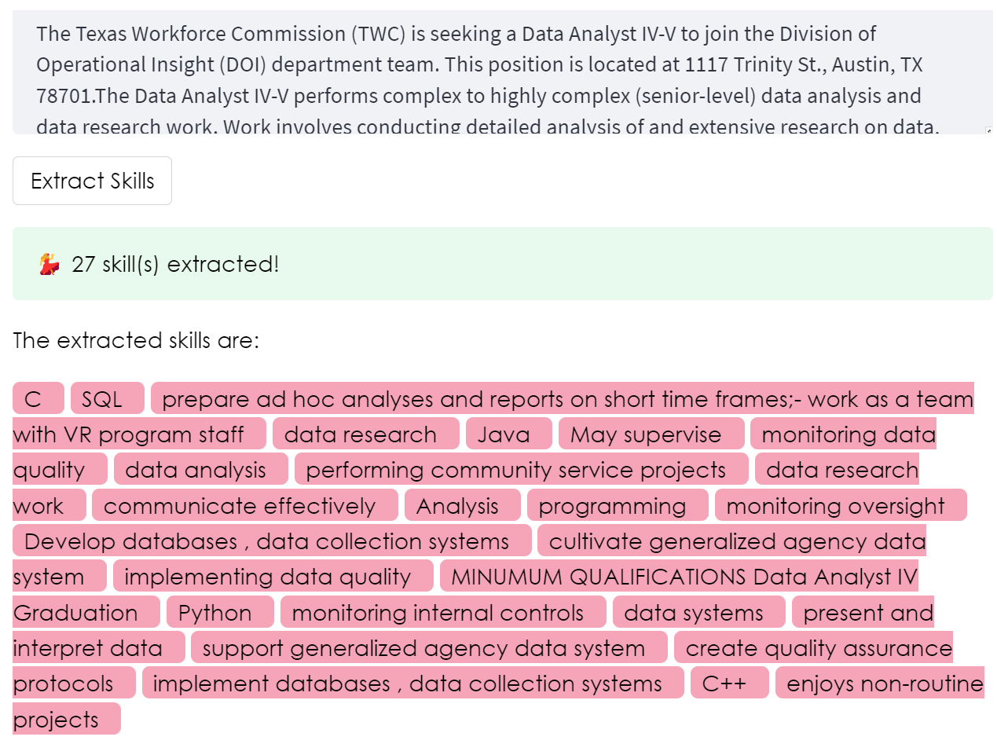
Skills Extraction
Parse through unstructured freeform text in the NLx job description column.
Apply open-source Python libraries designed for natural language processing (NLP) tasks.
Nesta’s Skills Extractor Library uses NLP via named-entity recognition (NER).
Source: https://www.nesta.org.uk/data-visualisation-and-interactive/skills-extractor-tool/

Slide 11
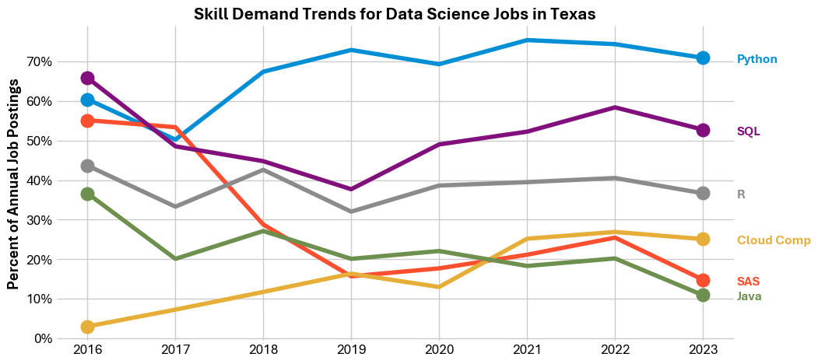
Changes in Skills demanded for Data Science
Texas Workforce Commission | Information Innovation & Insight
Data source: National Labor Exchange Research Hub

Slide 12
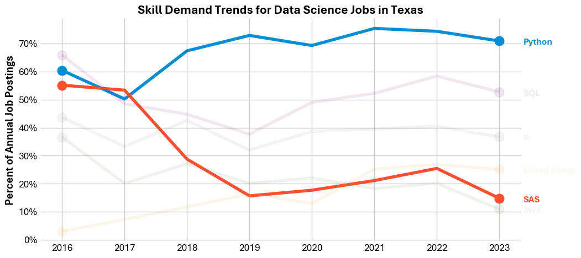
What would you teach?
Texas Workforce Commission | Information Innovation & Insight
Data source: National Labor Exchange Research Hub

Slide 13
Career Ladders may provide Predictive Power
Posting Type | Skill | June 2016 | June 2023
“Data” | Python | 8.7% | 27.8%
“Data” | SAS | 5% | Not in Top 20
“Data Scientist” | Python | 60% | 71%
“Data Scientist” | SAS | 55% | 15%

