Slide 1
Plans to improve search for jobs and trainings

Slide 2


Bill McMahon
Jamie Buss
Content & Data Manager
Senior Business & Data Analyst, XPAND
Thank you for having us today!
Notes:
Introduce self and title, history in relevance to audience
** Add photo of self or hobby/interest to add personal touch and story

Slide 3
What is CareerOneStop?
Using AI to improve job search
New workforce training data
Questions
Notes:
Today we’re gonna cover ….

Slide 4


What is CareerOneStop?
A comprehensive career, education & employment website
Notes:
CareerOneStop IS your source for career exploration, training, and jobs
We are a national website offering career resources and workforce information to job seekers, students, businesses, and workforce professionals.
CareerOneStop contains a set of online tools that integrate economic and workforce development activities and support talent development and success.
Our site is responsive, so will work on a variety of electronic devices and the entire site can be translated in Spanish by clicking on the upper right corner globe icon of any page.
Bill will provide some historical perspective. Long-term partnership with NLX. We listen to our users, intermediaries and counselors.

Slide 5

CareerOneStop Key Features
Trustworthy
National
Scope
No Cost
Notes:
Here are some key features of CareerOneStop to keep in mind:
#1 – We are Trustworthy
Sponsored by the U.S. Department of Labor Education & Training Administration
Bring quality data and reliable resources together into one creditable system
National scope
Serve all 50 states and US territories (can search and filter by local, state, & national levels)
Resources are 100% FREE
Absolutely No cost to users
Have no user account requirements (have user account functionality to save information, but account is NEVER required to access information)
No advertisements or popups while using the site

Slide 6

Using AI to improve Job Search
Notes:
We plan to use AI to improve Job Search.
Why? What does AI get us?

Slide 7
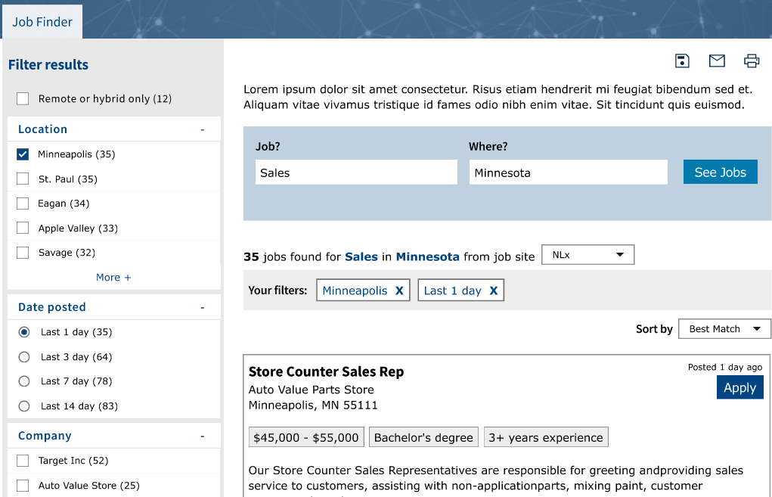
A.I.-enhanced Job Finder, proposed
Notes:
Better searching! Some cool new features will be enabled by AI-enhanced data.
Simple KW search has serious limitations.
There’s no standard format/structure or vocabulary used in job postings, as provided to D.E. by employers.
the challenge is too complex and dynamic for solutions like RegEx
Implied knowledge goes into postings.
AI allows us to restore and amplify context that’s currently not available thru simple KW-based job search. Example: BSN
This mockup shows plans for Job Finder. This is a results page.
* Note the new structured data in the job posting listed on the right, among search results
* Note filters on the left – I’ll show some new filters in a minute.

Slide 8
Jobs data: new properties
New derived properties
Education requirements
Experience requirements
Shift
Full-time / part-time
Wages
Remote

Slide 9
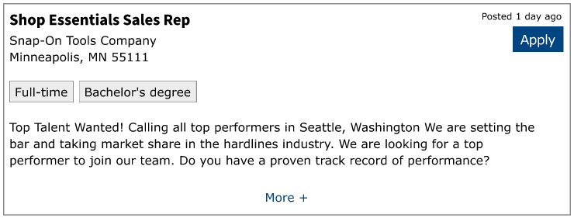
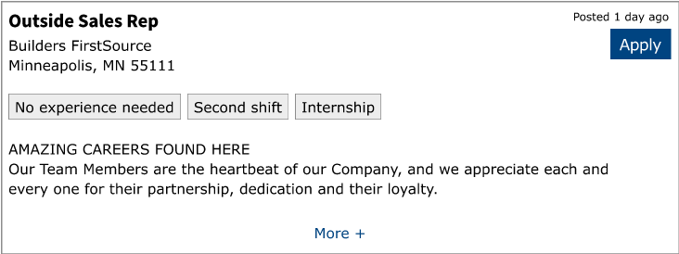
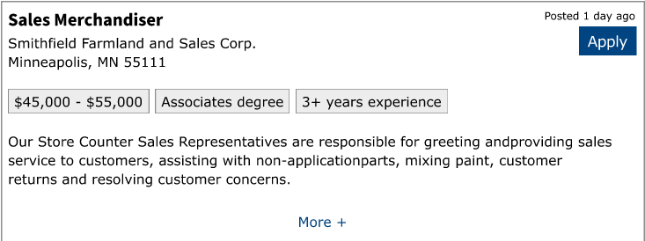
A.I.-enhanced Job Finder, proposed new properties
Notes:
Each job will have values for up to 6 new properties

Slide 10
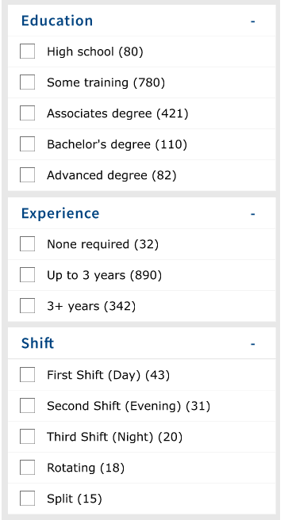
A.I.-enhanced Job Finder, proposed new filters
New derived property | Filter
Education requirements | Categorical
Experience requirements | Categorical
Shift | Categorical
Full-time / part-time | Yes
Wages | No filter
Remote | Not new, but better
Notes:
And we’ll offer new categorical filters
You could think of the categorical ones as having a limited # of buckets.

Slide 11

Jobs data, AI model in production
NLX jobs
XML format
Goal:
Enhanced data
Displayed publicly via Job Finder & API
A.I. model
(NER)
Pre-Process
Tool: .NET
Produces: jobs in JSON
CareerOneStop
Job Finder
3 A.I. models
(Classification)
CareerOneStop
Jobs API
Additional properties
for each job
Notes:
Production, daily
The AI models stay the same, but the data that runs through them changes daily.
[Talk through the diagram]

Slide 12

What is Named Entity Recognition (NER)?
Notes:
We use Prodigy to identify the labels a/k/a text strings that are values for each of six “entities”
When they show up in Job Finder, or in jobs API, we call them “properties” or “fields”.

Slide 13
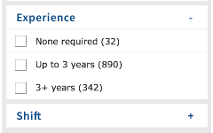
What is Text Classification?
Job descriptions say things like:
1-3 months experience
1 year experience required
Has worked for minimum 1 year
Required: 1-2 years experience
Experience required: 1+ years
2-4 years experience
5-7 years experience
Entry level
Job Finder will offer filters:
Notes:
Job descriptions say things like …
Meanwhile, JF will offer filters with categories.
… so we have to
Recognize the label that discusses each entity,
Then assign the corresponding classification
During the training process, we manually connect each label with the appropriate classification.
Then when we run the model, the model can make the assignment auto-magically.

Slide 14
Jobs data, training our A.I. models
Recognize Values for Entities
(NER model)
Classify values
(for 3 entities w/controlled vocab)
NLX jobs
XML format
Classify entity labels
Manual process
Tool: Prodigy
Products
(for internal use only):
Label entities (a/k/a Annotate)
Manual process
Tool: Prodigy
Create NER Model
Automatic process
Tools: NLP libraries, spaCy, transformers
Create Classification Models
Automatic process
Tools: NLP libraries, spaCy, transformers
Pre-Process
Tool: .NET
Produces: jobs in JSON
NER model
Ready for production
Candidate A.I. model
(NER)
3 Candidate A.I. models
(Classification)
3 Classification models
Ready for prod
Evaluate model
by evaluating its output, manually
Tools: Prodigy, StreamLit,
and custom UI
Evaluate models
by evaluating its output, manually
Tools: Prodigy, StreamLit,
and custom UI
Good enough?
Good enough?
Yes
No
Yes
No
Notes:
Development stage of the process; this process doesn’t go on ad infinitum, but only until we have models fit for production.
This is not an “exploded” version of the other process; it’s a little different.
[talk through the model]
Prodigy watches what you do, learns from your input to improve annotation going forward.

Slide 15
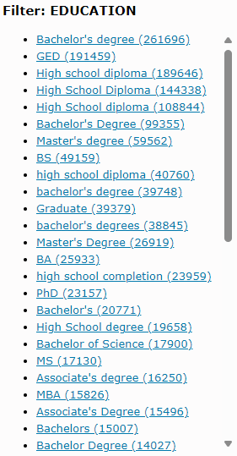
NER model evaluation
Notes:
This is an interface we’ll use to identify false positives, A/K/A negative cases

Slide 16
Deployment plans
Interface | Deployment plan
Job Finder | tbd
API v2 extended with new properties and filters | 1-2 months later
Notes:
API v2 Initial launch: August 2024.
No additional properties or filters, yet
but a better search, and
better performance and reliability
ANY QUESTIONS?

Slide 17
Adding WF trainings to Training Finder
Notes:
WHAT IS THIS NEW DATA?
LTF has long offered a window to IPEDS training data. From US Dept of Ed.
IPEDS data is accredited (mainly academic), with some reach into workforce training.
WIOA funds workforce trainings, mainly shorter-term, mainly not academic. DOL recently collected this data from all the states and started making it available.
SCOPE of the data: all programs that have been approved for any WIOA participant, in any state.
Some states cull (from prior years), others don’t.
ETP data is mainly about workforce trainings, with some reach into accredited, academic-oriented training.

Slide 18
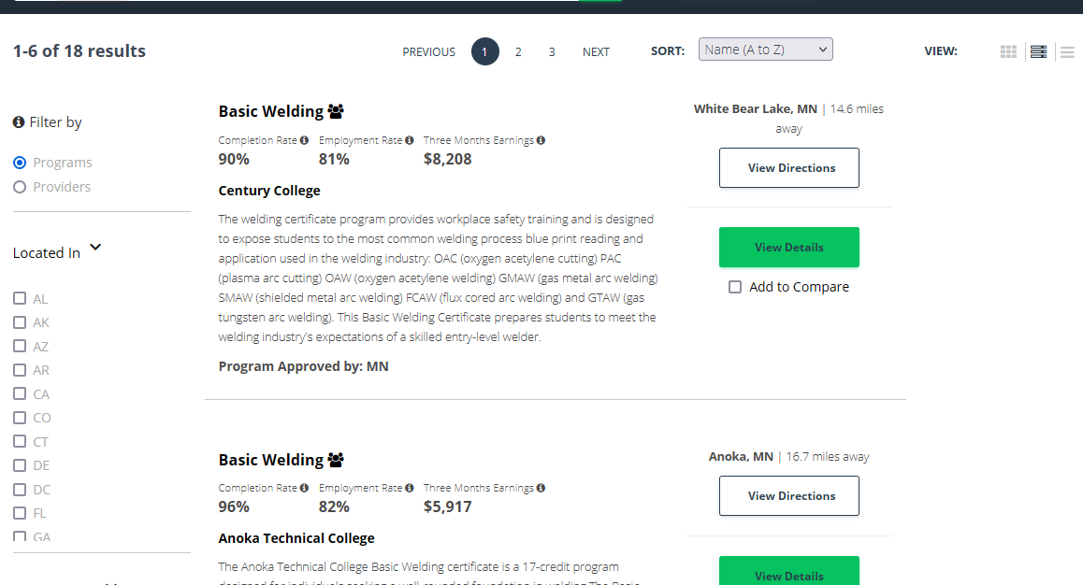
www.TrainingProviderResults.gov
Notes:
Data is from the US DOL ETA, WIOA staff measuring and monitoring performance.
States are required to report data back, as a requirement of receiving the funding. This is administrative data.
This user interface is available. Users can search for trainings. We’ve been working together with this group as partners for a couple years. We’re syndicating this data in a different context. We’re opening up additional possibilities for this data, to help more people find trainings.
They provide fresh training data to COS every year.

Slide 19
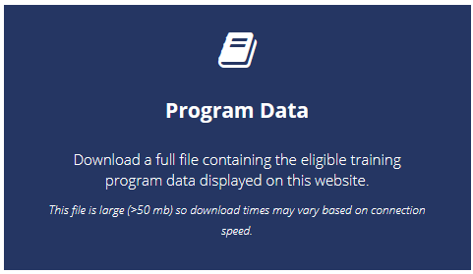
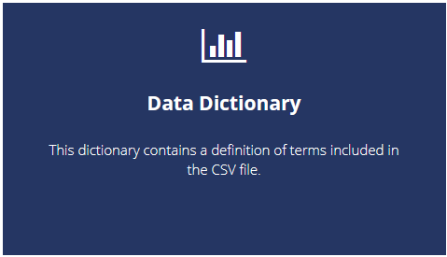
www.TrainingProviderResults.gov
Notes:
From here, you could download the data yourself.
OVERLAP with IPEDS: yes, there’s some. It’s substantial. We’re not especially concerned.
QUALITY: it’s an emerging dataset. Not highly controlled. But very valuable and promising nonetheless. Say: things are misspelled, missing, not controlled values.

Slide 20
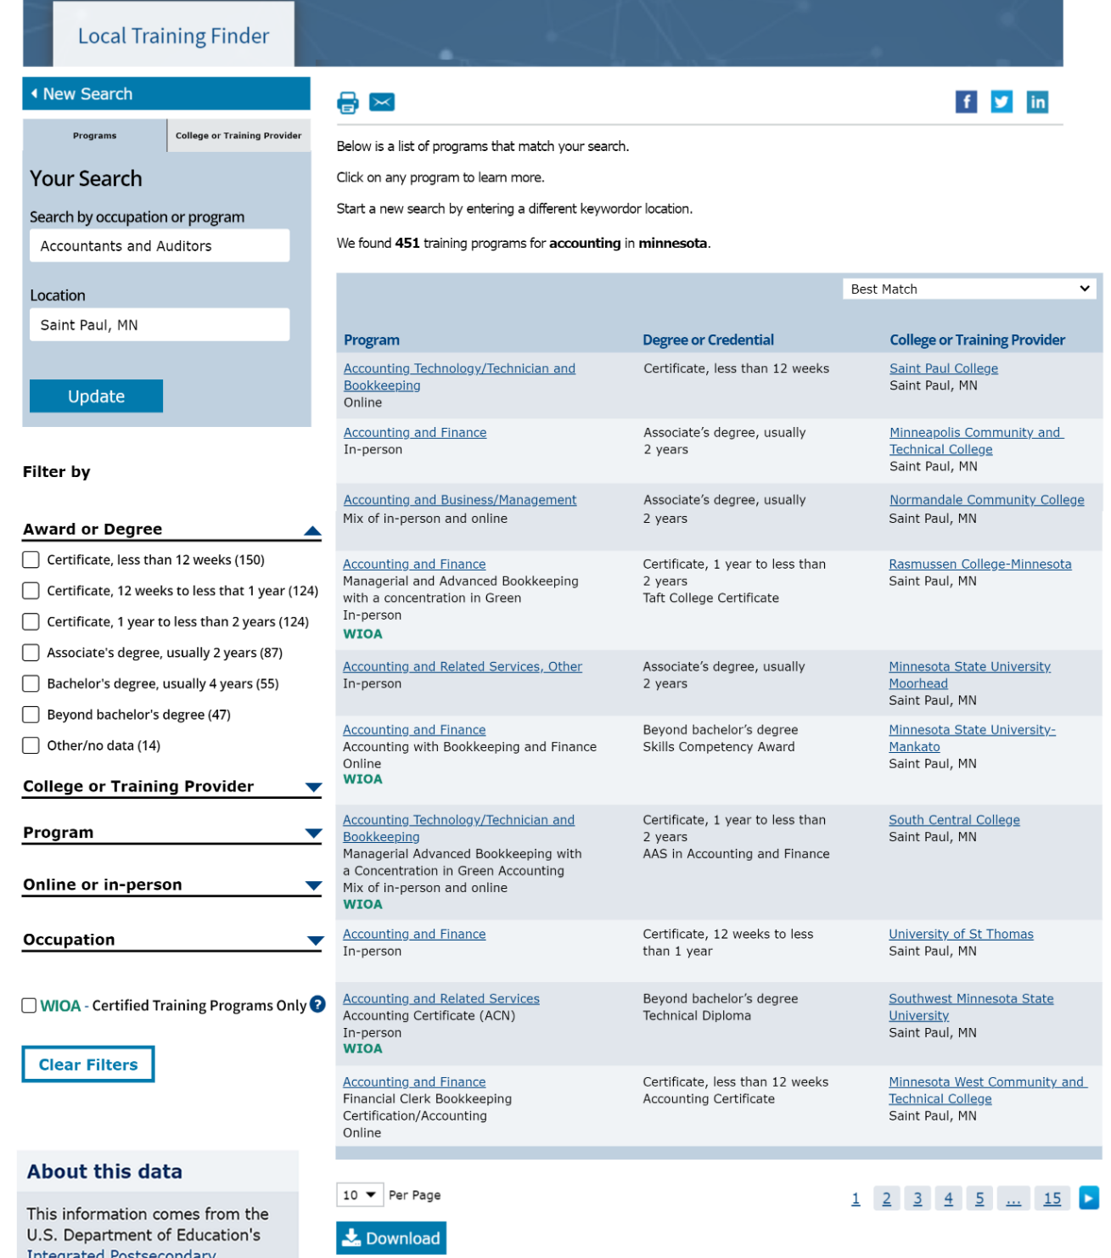
Training – Local Training Finder, program results
Notes:
WHY DOES COS want this data?
ETP data is on target for COS intended audience; Many COS users seek WF level trainings that aren’t in IPEDS. Examples: Microsoft applications or truck-driving vs nursing or economics
ETP data is interesting not only to people eligible for funding but many other COS users as well.
(only a small % of users qualify for DOL funding),
WHAT WILL COS DO?
The Local Training Finder tool shows trainings from both sources, integrated.
One user interface, one tool for all users.
HOW did we bring the disparate data together in one interface?
Key elements in common:
Providers, locations
Training name (using CIP taxonomy, classification of instructional programs)
Level / award
Some challenges aligning the data:
. Provider names … we couldn’t be sure. Not reconciled
. Level, we made informed guesses, based on credential, ETP outcome, and lengths
. Format is different. IPEDS is about indicating all-online, doesn’t recognize hybrid.
. Use CIP as the training program name; In ETP, changed 2010 CIP codes to use the 2020 CIP
ETP vs IPEDS, different fields:
Program data that’s in ETP but not IPEDS. Name of program. Outcome. Credential (free-form). Description.
Provider data that’s in IPEDS but not ETP. Type. URLs. Enrollment.

Slide 21
Training – Local Training Finder, program results
Notes:
WHY DOES COS want this data?
ETP data is on target for COS intended audience; Many COS users seek WF level trainings that aren’t in IPEDS. Examples: Microsoft applications or truck-driving vs nursing or economics
ETP data is interesting not only to people eligible for funding but many other COS users as well.
(only a small % of users qualify for DOL funding),
WHAT WILL COS DO?
The Local Training Finder tool shows trainings from both sources, integrated.
One user interface, one tool for all users.
HOW did we bring the disparate data together in one interface?
Key elements in common:
Providers, locations
Training name (using CIP taxonomy, classification of instructional programs)
Level / award
Some challenges aligning the data:
. Provider names … we couldn’t be sure. Not reconciled
. Level, we made informed guesses, based on credential, ETP outcome, and lengths
. Format is different. IPEDS is about indicating all-online, doesn’t recognize hybrid.
. Use CIP as the training program name; In ETP, changed 2010 CIP codes to use the 2020 CIP
ETP vs IPEDS, different fields:
Program data that’s in ETP but not IPEDS. Name of program. Outcome. Credential (free-form). Description.
Provider data that’s in IPEDS but not ETP. Type. URLs. Enrollment.

Slide 22
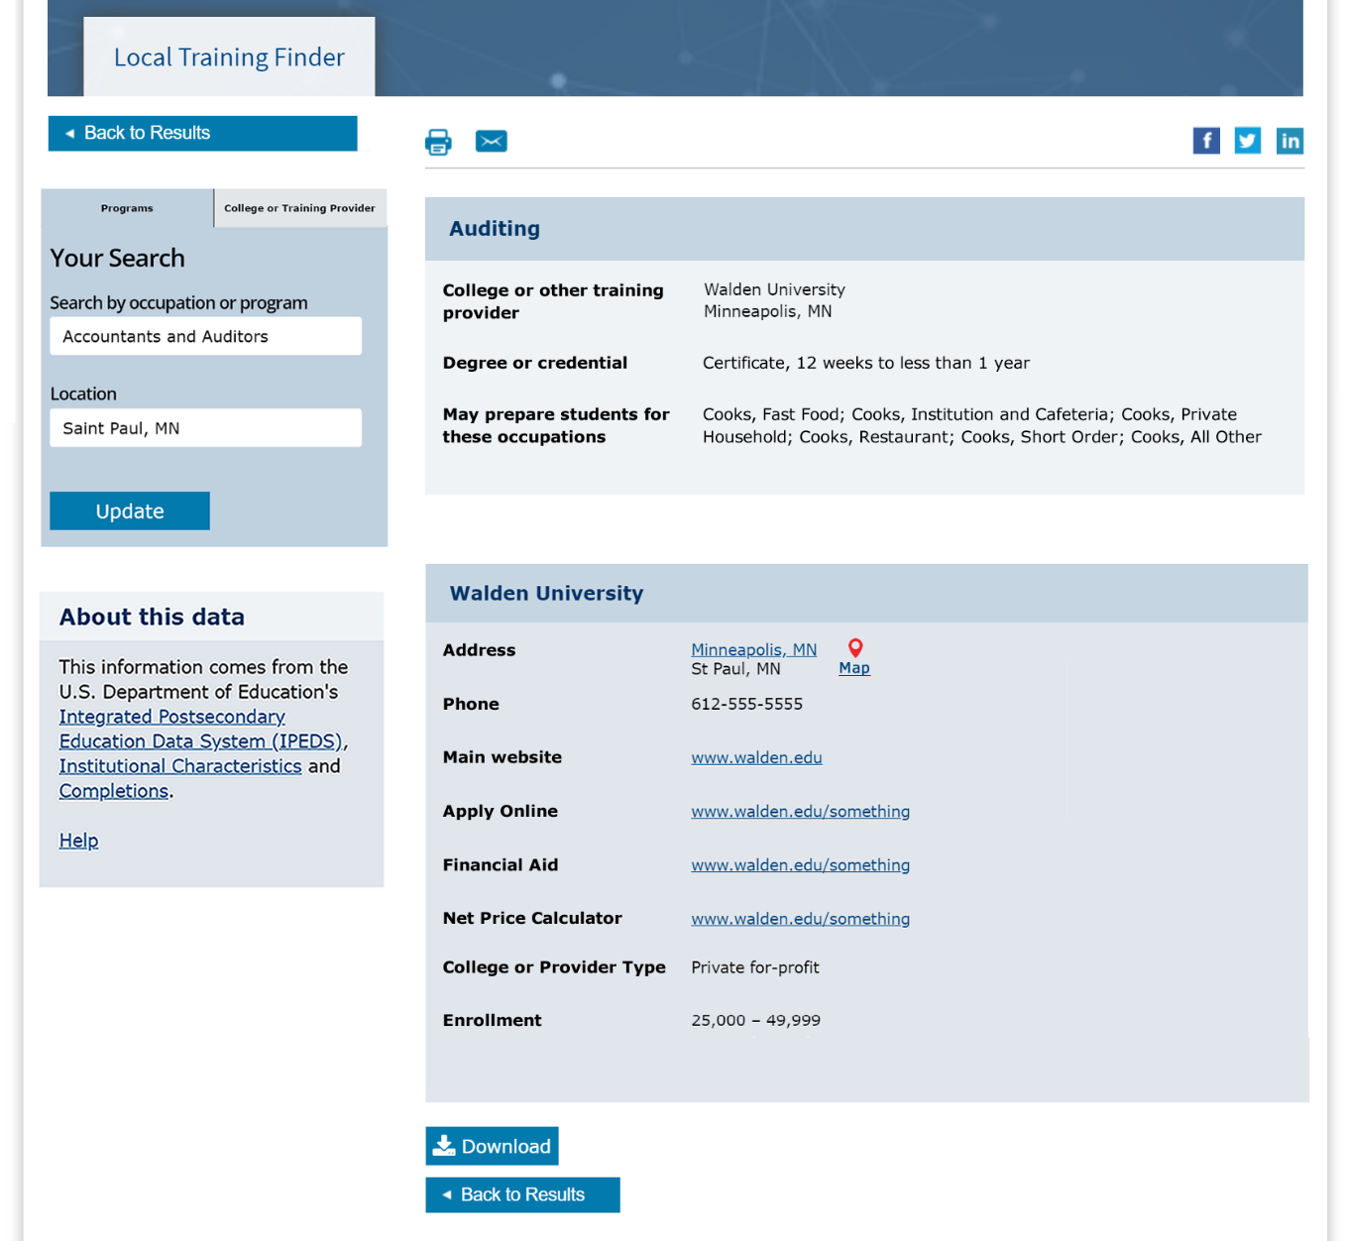
Training – Local Training Finder, IPEDS program details
Notes:
Details of an IPEDS program, available now.
IPEDS is mainly about institutions, and so IPEDS data on programs is a little skinny.
Remote vs hybrid vs in-person – coming soon.

Slide 23
Training – Local Training Finder, IPEDS program details
Notes:
Details of an IPEDS program, available now.
IPEDS is mainly about institutions, and so IPEDS data on programs is a little skinny.
Remote vs hybrid vs in-person – coming soon.

Slide 24
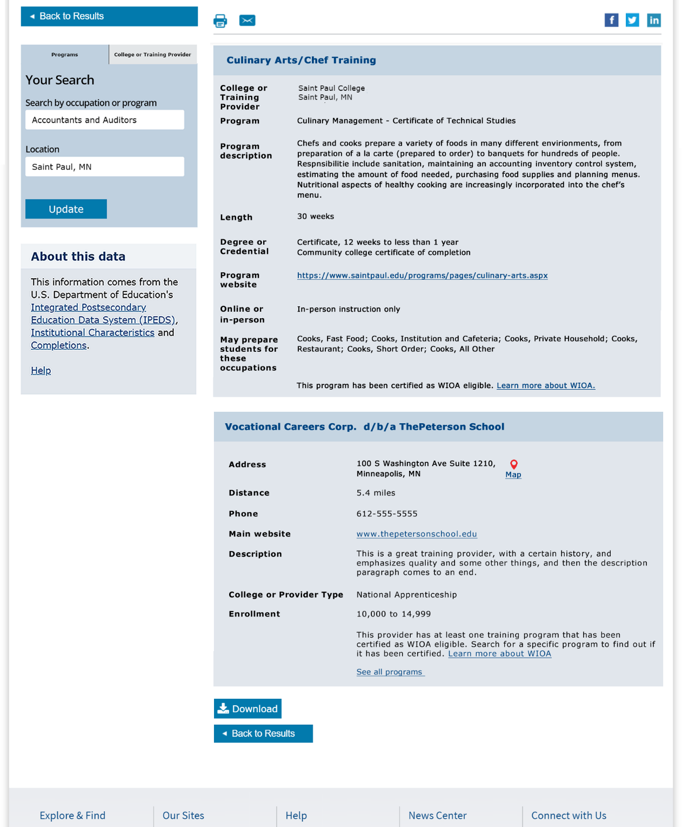
Training – Local Training Finder, ETP program details
Notes:
Details of an IPEDS program, available now.
IPEDS is mainly about institutions, and so IPEDS data on programs is a little skinny.
COS plans:
LTF: summer
Data download: forthcoming COS training download of the ETP data.
API: COS current training API (IPEDS only) vs future (mixed)
Hopes for the future:
Reconcile providers, programs
ETP provider URLs leave a lot to be desired; they’re mainly for programs
ETP provider types could align w IPEDS
Cost and Performance data – a lot is missing from both sets of data.

Slide 25
Training – Local Training Finder, ETP program details
Notes:
Details of an IPEDS program, available now.
IPEDS is mainly about institutions, and so IPEDS data on programs is a little skinny.
COS plans:
LTF: summer
Data download: forthcoming COS training download of the ETP data.
API: COS current training API (IPEDS only) vs future (mixed)
Hopes for the future:
Reconcile providers, programs
ETP provider URLs leave a lot to be desired; they’re mainly for programs
ETP provider types could align w IPEDS
Cost and Performance data – a lot is missing from both sets of data.

Slide 26
Local Training Finder, plans to deploy
Interface | Deployment plan
Local Training Finder | Summer
API | tbd
Notes:
Plans – read the slide
QUESTIONS?

Slide 27





Connect with us
@careeronestop
@CareerOneStop.org
Thank you
for your time!
CareerOneStop
@Career1Stop
Info@CareerOneStop.org
Notes:
Please feel free to ask any questions or give us recommendations.
Message us! We monitor emails and Social Media daily.

Slide 28
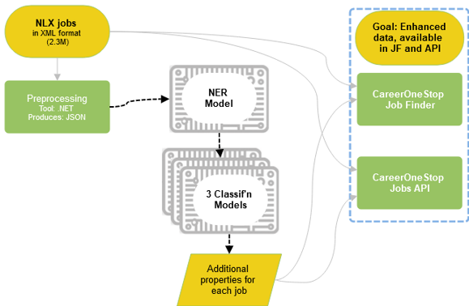
Jobs data, running our AI model
Notes:
In production, the AI will produce additional properties for jobs,
And then those properties will be available through both JF and API
The NER model recognizes entities, recognizes which text in a job description tells us about education requirements, which tells us about shift, etc.
The 3 Classification models take the labels for these properties:
Education level
Experience level
Shift
And takes the extra step of assigning a classification

Slide 29
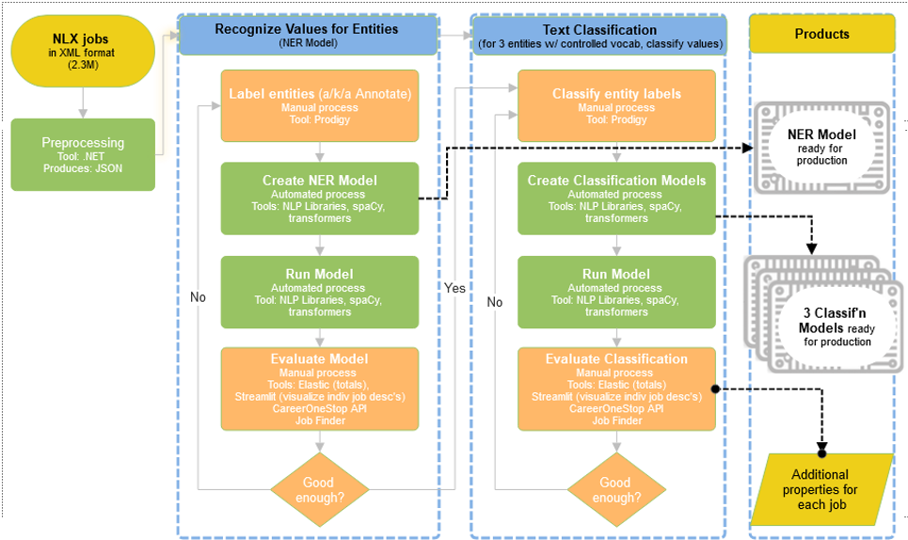
Jobs data, creating our AI model

Slide 30
Jobs data, running our AI model
NLX jobs
XML format
AI model
(NER)
3 AI models
(Classification)
Pre-Process
Tool: .NET
Produces: jobs in JSON
Additional properties
for each job
Goal:
Enhanced data
Displayed publicly via Job Finder & API
CareerOneStop
Job Finder
CareerOneStop
Jobs API

