Slide 1

Insights for Workforce Development from American Community Survey (ACS) Data
Jason Palmer
State Bureau Administrator
State of Michigan
Department of Technology, Management and Budget
Bureau of Labor Market Information and Strategic Initiatives
Notes:
Thank you for the opportunity to be here today.

Slide 2
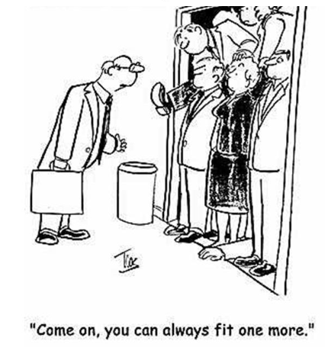
If you don’t already, get to know your State Demographer and SDC leads.
Michigan’s State Demographer sits in our Federal-State Programs Division.
The team administers MOUs/programs with Census Bureau:
  Federal State Cooperative for Population Estimates (FSCPE)
  State Data Center (SDC)
  Federal State Cooperative for Population Projections (FSCPP)
State funds also support two (2) analysts producing population and labor force projections for Michigan and its 83 counties.
Notes:
With the assistance of our Federal-State Programs Staff, we leverage data from the American Community Survey (ACS) for several projects, including:
Support for WIOA State and Local Plan
Occasional Paper Series
City and County Profiles
Occupational Insights
Several High-Profile Requests

Slide 3
“Analysis” for WIOA State and Local Plans
Plans must include: “An analysis of the current workforce, employment and unemployment data, labor market trends, and the educational and skill levels of the workforce, including individuals with barriers to employment (including individuals with disabilities), in the State.” 128 STAT. 1445.
Individuals with barriers to employment:
  Disability
  Low-Income Individuals
  Limited English Proficiency
  Single Parents
  Older Workers. See generally, 128 STAT. 1433-34

Slide 4

Occasional Paper Series
Produced for Michigan’s Office for New Americans (MONA), Michigan’s Foreign-Born Population and Workforce provides an overview of Michigan’s foreign-born population.
A cross tabulation of ACS variables provides the customers with information about:
  Labor force, employment, and unemployment characteristics, including occupational employment.
  Educational attainment, income, and other socioeconomic factors, including barriers to employment.

Slide 5
City and County Profiles
Recently featured on a LMI Institute/C2ER/LED Webinar, the City of Pontiac Demographic and Labor Market Profile uses ACS data to produce an wealth of local information.
  Think: Population size and structure; family and household characteristics; incidence of poverty; race and ethnic composition; educational attainment; and disability status, just to name a few.
With a Customer Satisfaction score of 85 percent, these profiles are one of our most popular products, particularly with regional and local customers.

Slide 6

Occupational Characteristics
We also use ACS data to glean information on occupational segregation, aging occupations, and educational attainment of existing workers.
You can find some of this analysis in various feature stories in our monthly flagship publication, Michigan’s Labor Market News.

Slide 7
High-Profile Requests Using ACS Data
Attorney General’s Office – We used ACS data to estimate the number of persons who identified as Native Americans in a Michigan county for litigation in Little Traverse Bay Band of Odawa Indians v. Snyder.
Michigan Department of Education – We use custom tabulations from the ACS to provide the customer with the number of children at various levels of poverty by Intermediate School District (ISD).
Michigan Office of Aging – We use ACS data to classify zip codes as rural or nonrural to support Michigan’s applications for federal grants.
Notes:
(user defined geographic and specific population.)

