Slide 1
Jeff’s
Hallucinations about AI
Jeff DeBellis
Director of Economic & Policy Analysis
NC Department of Commerce, LEAD

Slide 2
25-year Evolution of Commercial AI Products
1997: The auto-complete feature in MS Word was introduced, as part of the AutoCorrect function. It was one of the first applications of natural language generation.
1998: The first online recommendation system was developed by Amazon, using item-to-item collaborative filtering.
2000: Netflix introduced its recommendation system, using a hybrid approach of collaborative filtering and content-based filtering.
2004: Gmail introduced its spam filter, using a technique called neural networks.
2011: The first voice assistant to be widely available on smartphones was Siri, introduced by Apple with the iPhone 4S.
2011: The first smartphone to offer face unlock was the Samsung Galaxy Nexus, based on simple 2D image recognition.
2011: Spotify launched its recommendation system, using a combination of collaborative filtering, natural language processing, and audio analysis.
2014: Alexa, which was originally launched by Amazon as part of the Echo smart speaker, became available on smartphones through the Amazon app.
2014: The first smart home device to use AI was Nest, which was acquired by Google. It used a technique called reinforcement learning to adjust the temperature based on the user’s patterns and preferences.
2015: Google introduced facial recognition to its photos service, as part of the Google Photos app. It was one of the first applications of deep learning.
2016: Google Assistant followed Siri, initially as part of the Google Allo app and later as a standalone service.
2017: The first smartphone to offer a secure and reliable face unlock was the iPhone X, which used a technique called Face ID, which projected a 3D map of the user’s face using infrared dots.
2017: The first AI system to beat a human professional player at the board game Go was AlphaGo, which was developed by Google’s DeepMind. It used a technique called deep reinforcement learning.
2019: Samsung and Huawei followed iPhone X, introducing their own versions of 3D face unlock.
2020: The first AI system to generate natural language text from a given prompt was GPT-3, developed by OpenAI. It used a technique called deep neural language model.
2021: The first AI system to create realistic images from text descriptions was DALL-E, which was also developed by OpenAI. It used a technique called generative adversarial network.

Slide 3
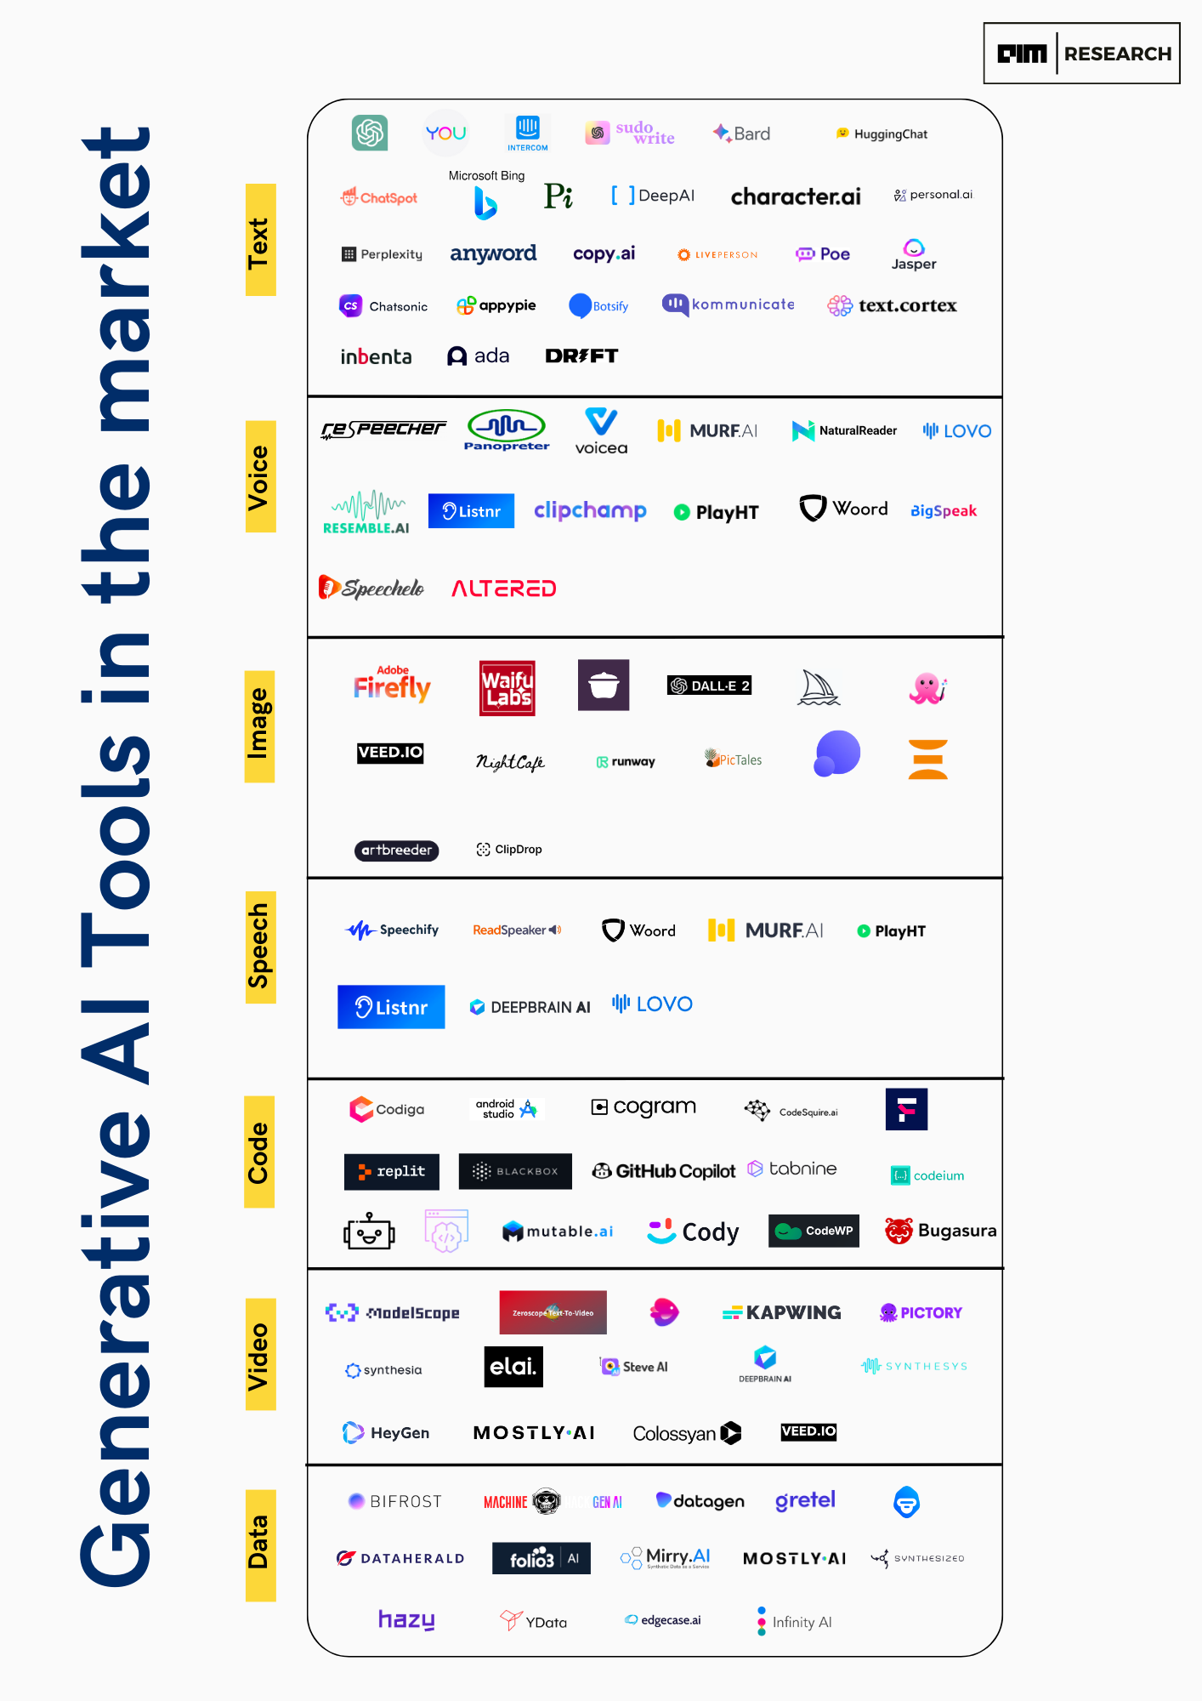
What is Generative AI?
Text
Image
Code
Data
Voice
Speech
Video
More than ChatGPT
A category of machine learning algorithms that can produce original content in response to prompts
The first tool to help humans “think”.
https://aimresearch.co/product/generative-ai-tools-a-comprehensive-market-analysis/
Notes:
There is more to generative AI than ChatGPT…
Today, generative AI can learn and synthesize not just human language but other data types including images, video (sora), software code, and even molecular structures

Slide 4
Automation vs AI
Automation - the mechanization of repetitive tasks
  Fairly predictable impacts – seen this before
  Slow to implement - expensive to transition
  Heavily impacting blue-collar industries
    Manufacturing, Transportation / Warehousing, Ag, Mining
  Heavily impacting lower-educated occupations
  Creates needs for higher-skilled workers
Artificial Intelligence - ability of machines to learn & make decisions
  NEW – unpredictable?
  Potential for very rapid change – can be lower cost
  Heavily impacting white-collar industries
    Biz/Tech, Finance, Administration, Real Estate, etc.
  Heavily impacting higher-ed occupations
  Impact on skilled workers?

Slide 5
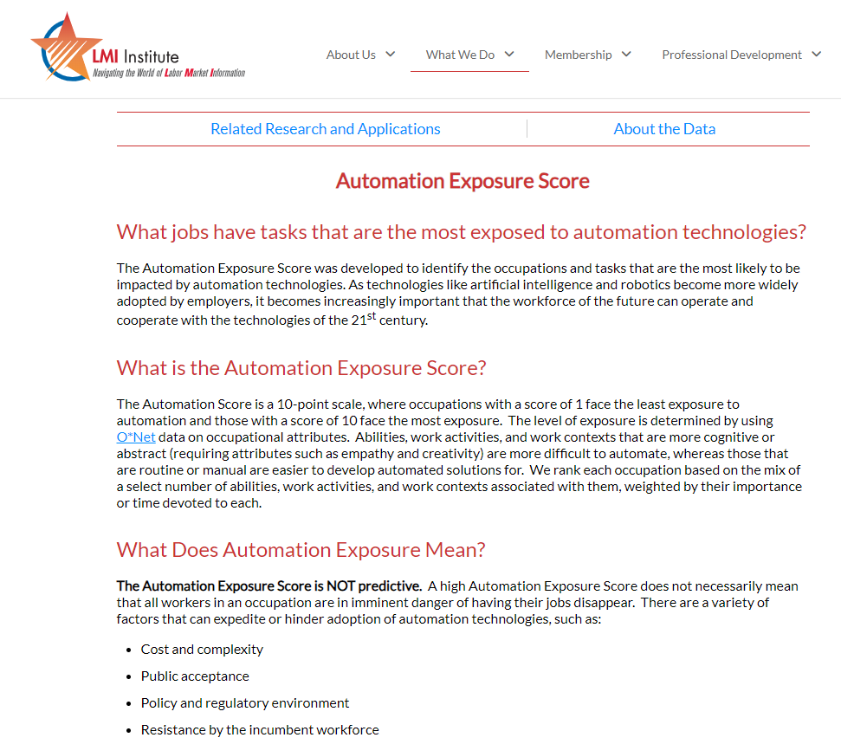
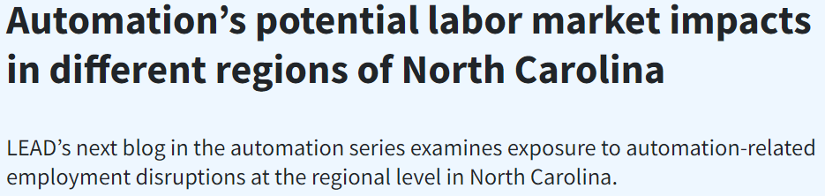
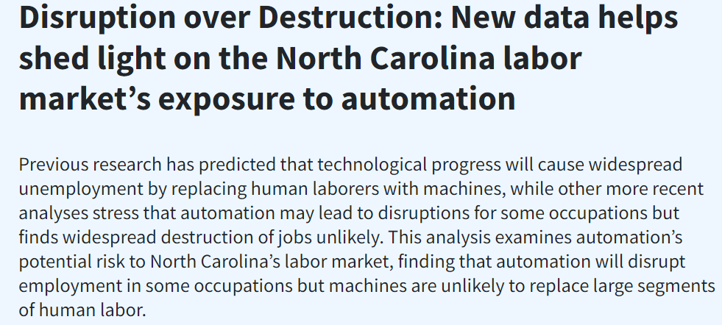
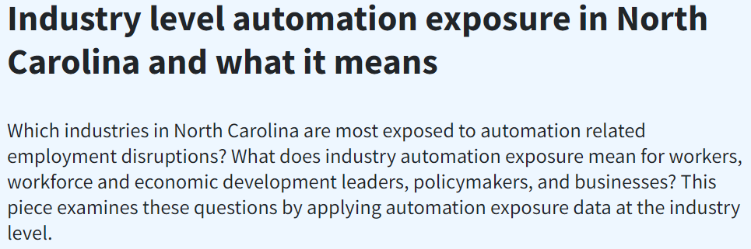
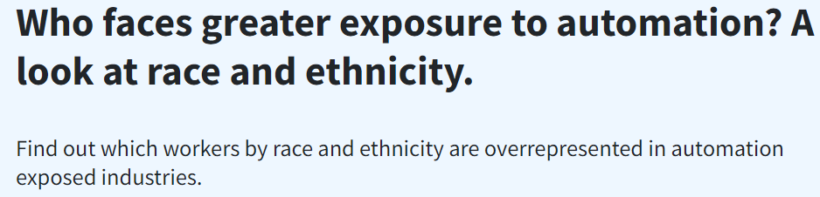
Why Focus on Generative AI?
Differentiate from Automation
Inform products
  Employment projections
  NCcareers.org
  Economic presentations & Blog articles
    The LEAD Feed
      Commerce.NC.gov/News/the-Lead-Feed
Stay relevant to customers

Slide 6
Theories
What Occupations May Be Exposed to AI?

Slide 7
Examined Several AI Studies
Frequent Considerations:
Types of Activities
Types of Abilities
Work Context – Impact on outdoor/physical activities
Importance vs level
Proportion of time/effort intensity
Person-to-Person responsibilities

Slide 8
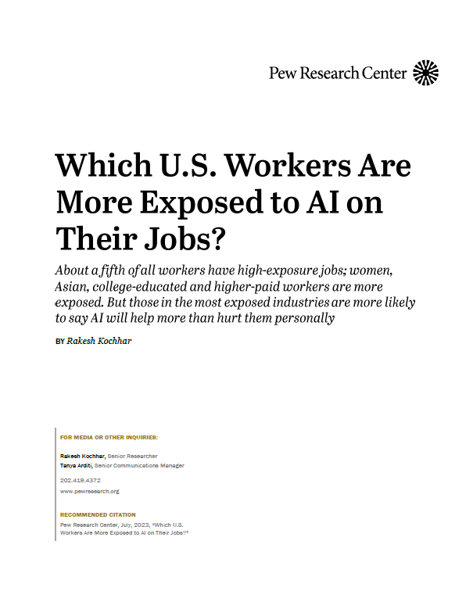
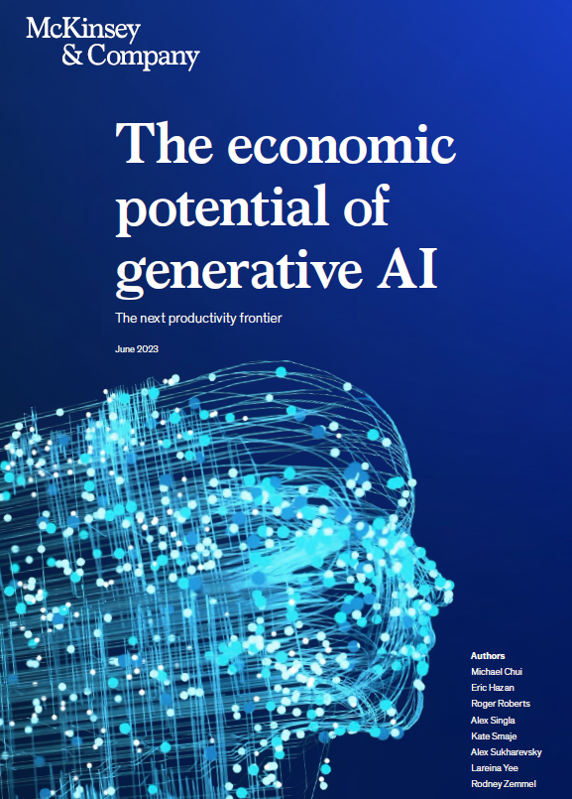
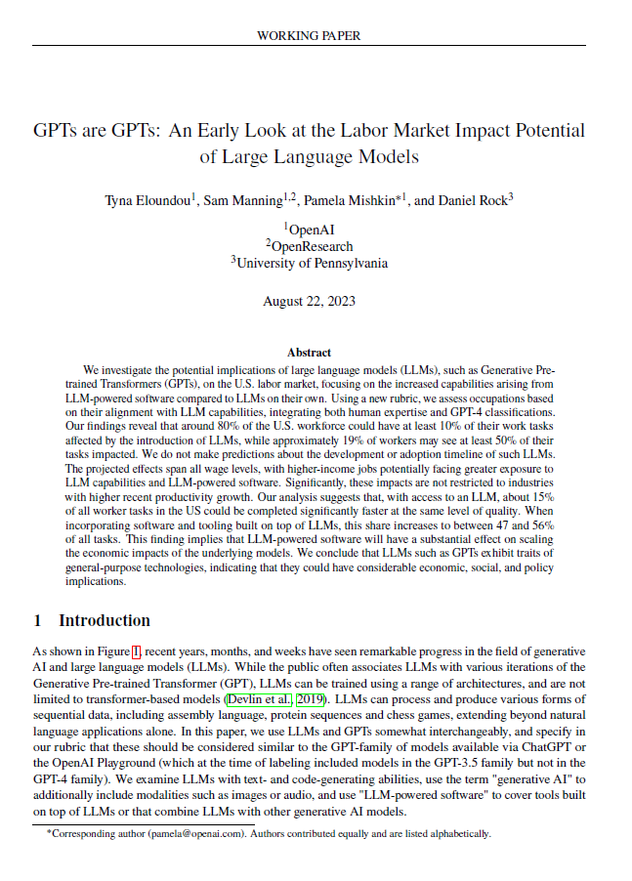
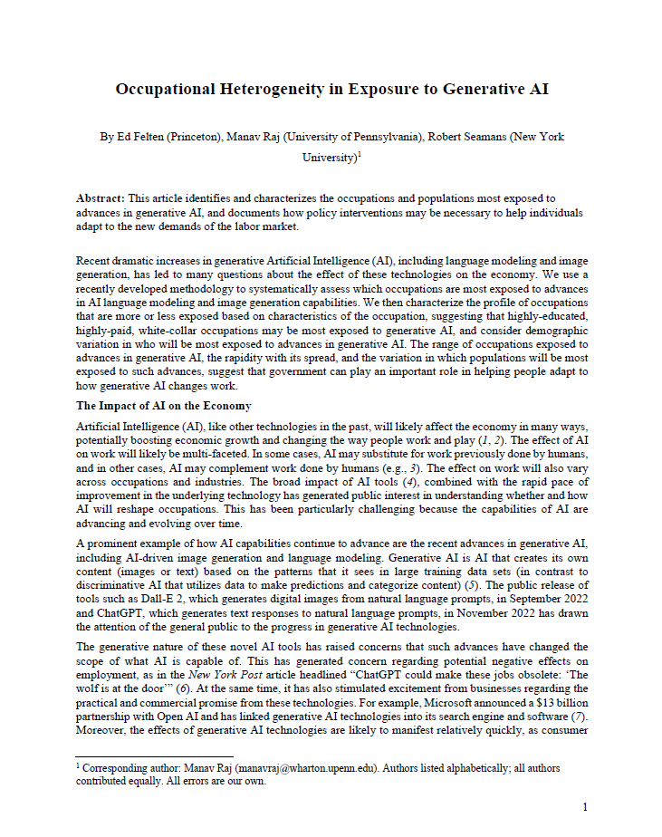
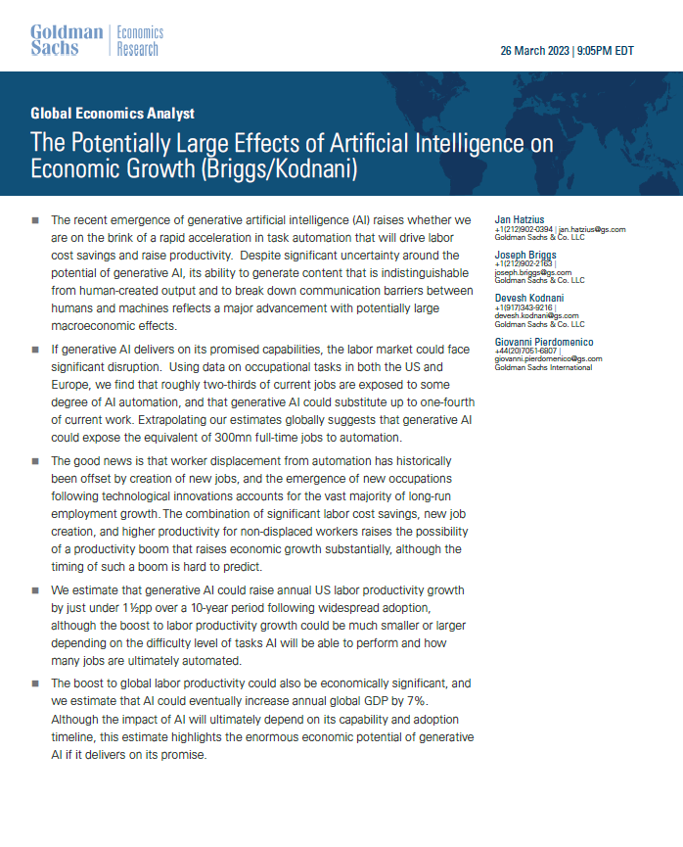

O*NET-Based AI Research
Work Activities – PEW
  Focus on Importance
  Low, Medium, High exposure
Work Activities + Chat GPT – OpenAI
  Importance + Chat GPT “opinion”
Work Activities + Work Context – Goldman Sachs
  Importance + Level
  Considered No Automation, Augmentation, Replacement
Work Activities + Professional Assessments – McKinsey
  Level + Analyst Assessments
Work Tasks – World Economic Forum
  Focus on Tasks + BLS hours
  High potential for Automation; High potential for Augmentation;
  Low potential for Augmentation; Little/No Impact
Abilities + Surveys – Felten et al
  Importance * Level

Slide 9
Result Distinctions
Dependent on type of AI – Language or Image-Generating
Potential for disruption – time vs skill intensity vs replacement/augmentation
Impact on Postsecondary Teachers
Impact on licensed professionals – Lawyers, Pilots, Doctors, Psychologists, Counselors, CPAs, etc.
Impact on creative professions – Artists, Musicians, Writers
Impact on leaders – Managers, Clergy

Slide 10

Common Results
Little to no impact on Physical/Outdoor Occupations
Most prominent occupation groups:
  Office/Administrative
  Architecture/Engineering
  Business/Finance
  Life/Physical/Social Science
  Computer/Mathematical

Slide 11
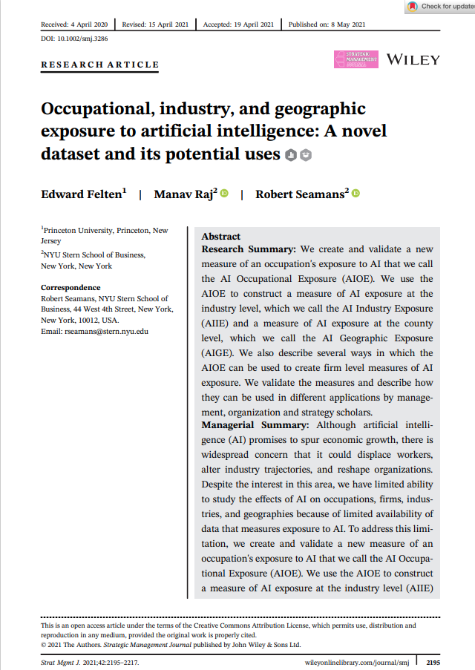
AI Exposure by occupational group
Higher AI Exposure
Lower AI Exposure
Analysis of data from Felten, E., Raj, M., & Seamans, R. (2021). Occupational industry and geographic exposure to artificial intelligence: A novel dataset and its potential uses. Strategic Management Journal, 42, 2195–2217. https://doi.org/10.1002/smj.3286
Notes:
One widely used and well-known example is Felten et al’s AIOE score which determines which occupations may be exposed to AI by looking at the overlap between AI applications and the abilities needed to perform an occupation
Note that this measures relative exposure, not necessarily if the jobs will be replaced or complemented by AI.
Looking at the high-level occupations (2-digit SOC codes), we see that the occupations most likely impacted according to the AIOE score tend to be white collar/ office jobs, like
Whereas, The occupations predicted to be least impacted are more physical in nature, require in-person interaction, and in some cases are performed outdoors.
This is one methodology for assessing the impact of AI on the labor market, others have used additional methods to assess which jobs may be complemented by AI.

Slide 12
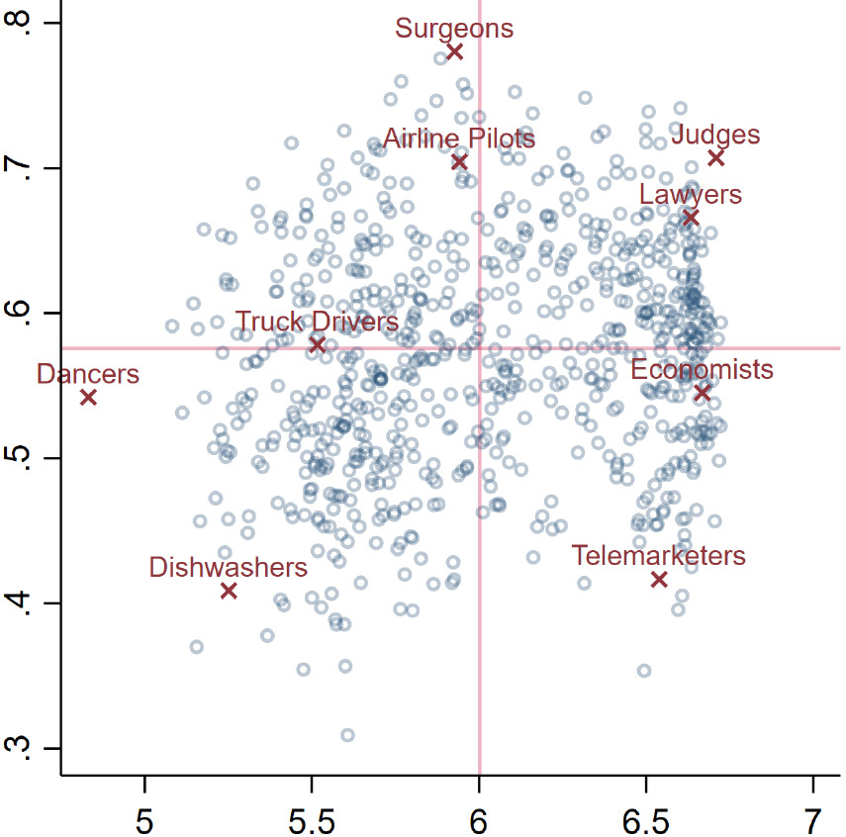
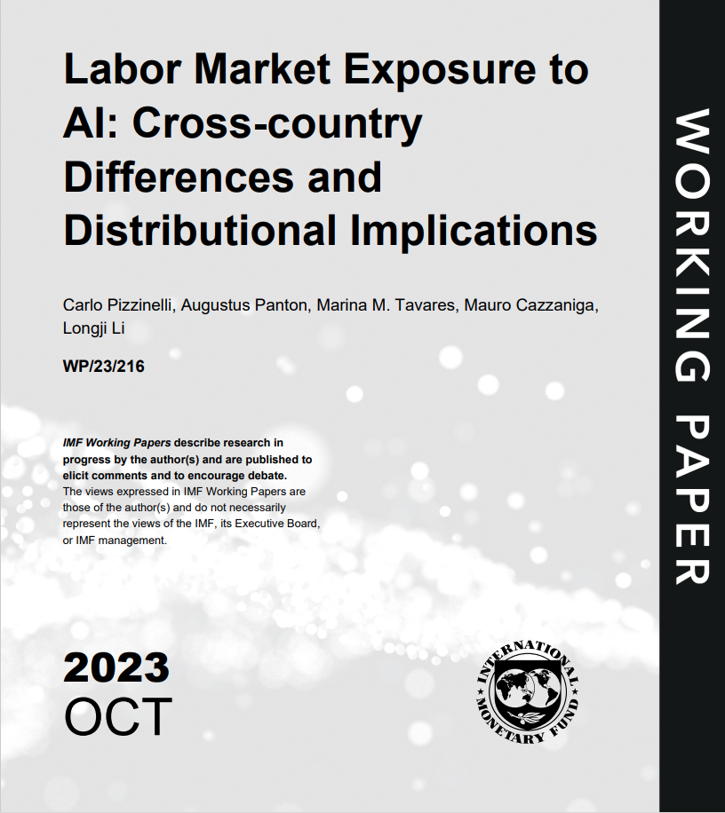
AIOE vs
Complementarity
Enhance
Little Impact
Complementarity
Replace
Exposure
Pizzinelli, C., Panton, A., Tavares, M. M., Cazzaniga, M., & Li, L. (2023). Labor Market Exposure to AI: Cross-country Differences and Distributional Implications
Notes:
Built upon Felten’s AIOE score by assessing complementarity of AI to occupations by incorporating certain O*NET measures like the likelihood of an occupation requiring face-face interactions, have responsibility for others and outcomes, having a high consequences of errors, etc.
For example, Surgeons, Pilots, Judges, and Lawyers all fall in the high complementarity zone

Slide 13
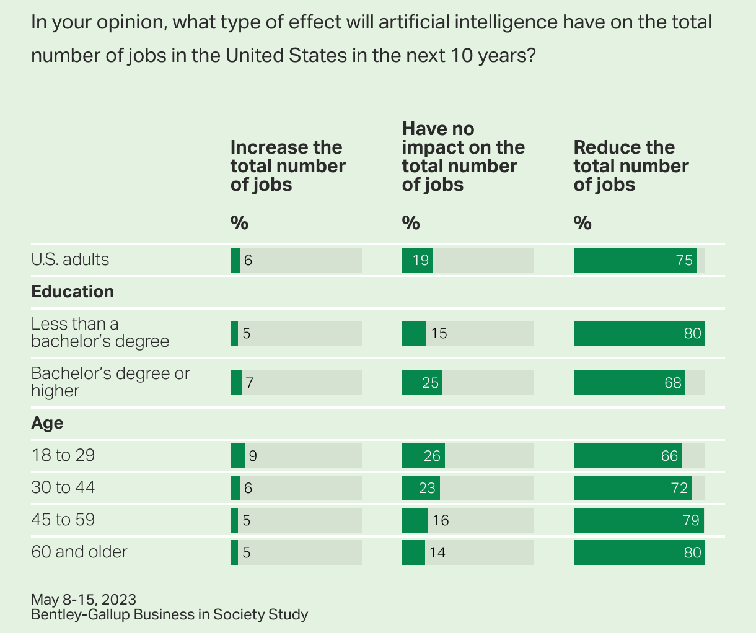

75% of Americans
Believe AI Will Reduce Jobs

Slide 14
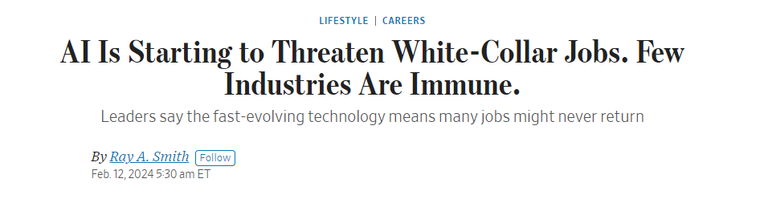
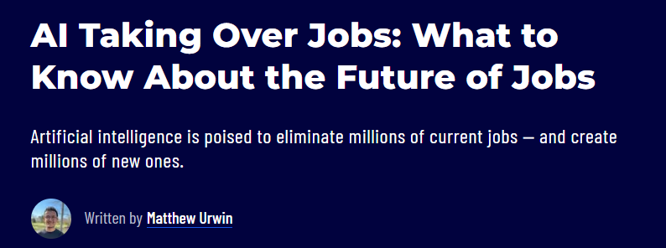
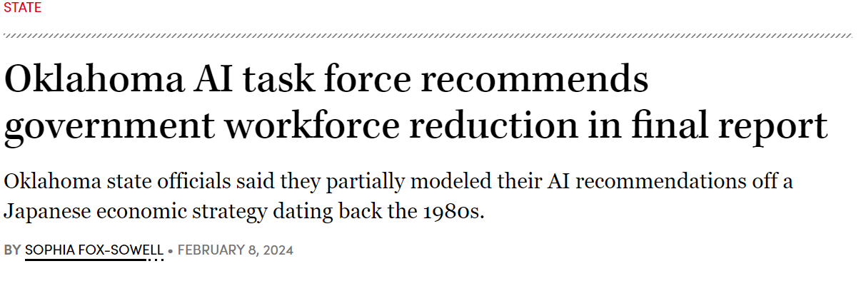
“…The thing we need to confront as a society is the speed at which this is going to happen.”
- Sam Altman, Open AI
“…the state would reduce public sector human employees by 40% in favor of a more efficient workforce of “digital employees.”
Notes:
AI doomsday scenarios

Slide 15

AI May Increase Productivity
Research shows AI can improve productivity on a variety of tasks, like:
  Business Writing (Noy & Zhang 2023)
  Programming (Peng et al 2023)
  Customer Support (Brynjolfsonn et al 2023)
  Consulting (Dell’Acqua et al 2023)
Stronger benefits to less experienced, lower skilled workers
Democratization of skills
  How AI Could Help Rebuild The Middle Class (Autor 2024)

Slide 16
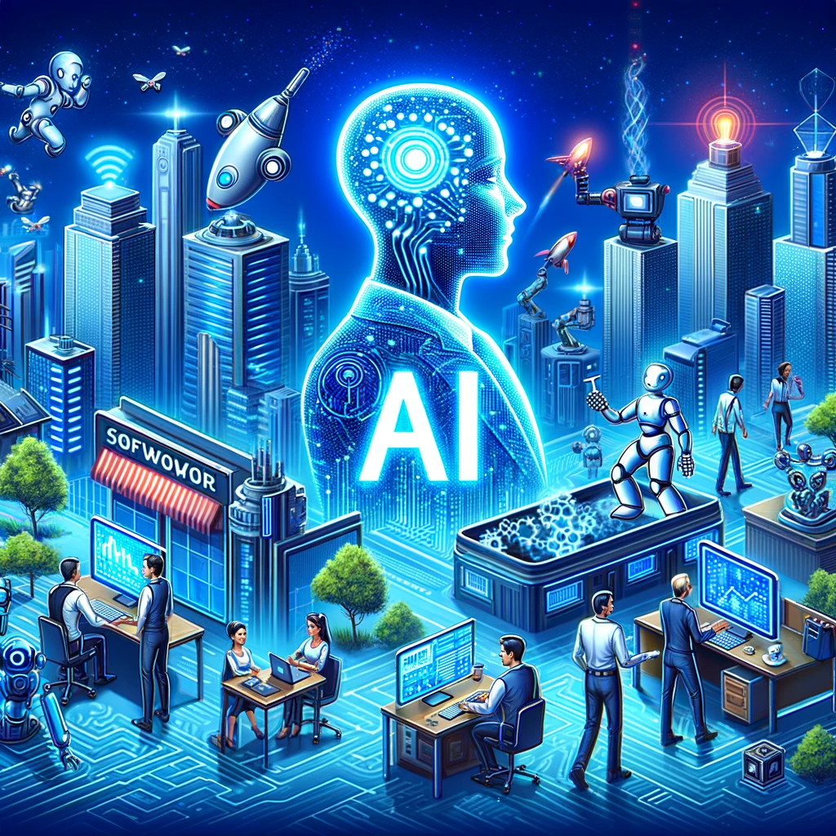
AI May Create NEW Jobs
Trainers – developing AI
  AI Engineers, scientists
Explainers – making AI easy to use
  AI UX designers
Sustainers –making sure AI is used optimally
  AI content creators, data curators, ethics and government specialists
https://www.weforum.org/agenda/2023/09/jobs-ai-will-create/

Slide 17
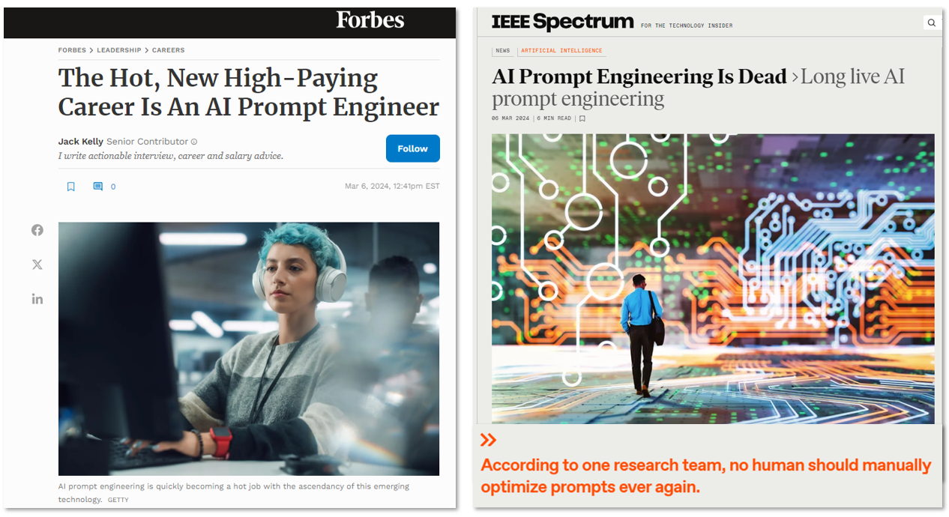
Notes:
Prompt Transformation replacing Prompt Engineering

Slide 18
Evidence
How Are Employers
Using AI?

Slide 19
Little Use 6 Months Ago
, but Optimistic
United
States
North Carolina
September 2023
Source: U.S. Census Bureau, Business Trends and Outlook Survey (BTOS), Reference Period 9/10/23 & 3/24/24
Notes:
For all questions referencing Artificial Intelligence (AI), the following definition is available as a pop-up: AI Definition: Computer systems and software that are able to perform tasks normally requiring human intelligence, such as decision-making, visual perception, speech recognition, and language processing. Types or applications of AI include machine learning, natural language processing, virtual agents, predictive analytics, machine vision, voice recognition, decision making systems, data analytics, image processing, etc.

Slide 20
But Usage Hasn’t Grown Much Yet
United
States
North Carolina
September 2023
March 2024
Source: U.S. Census Bureau, Business Trends and Outlook Survey (BTOS), Reference Period 9/10/23 & 3/24/24
Notes:
For all questions referencing Artificial Intelligence (AI), the following definition is available as a pop-up: AI Definition: Computer systems and software that are able to perform tasks normally requiring human intelligence, such as decision-making, visual perception, speech recognition, and language processing. Types or applications of AI include machine learning, natural language processing, virtual agents, predictive analytics, machine vision, voice recognition, decision making systems, data analytics, image processing, etc.

Slide 21
Although Optimism Continues
United
States
North Carolina
September 2023
March 2024
Source: U.S. Census Bureau, Business Trends and Outlook Survey (BTOS), Reference Period 9/10/23 & 3/24/24
Notes:
For all questions referencing Artificial Intelligence (AI), the following definition is available as a pop-up: AI Definition: Computer systems and software that are able to perform tasks normally requiring human intelligence, such as decision-making, visual perception, speech recognition, and language processing. Types or applications of AI include machine learning, natural language processing, virtual agents, predictive analytics, machine vision, voice recognition, decision making systems, data analytics, image processing, etc.

Slide 22
Little Change in Use Over Last 6 Months
United
States
North Carolina
Source: U.S. Census Bureau, Business Trends and Outlook Survey (BTOS), Reference Period 3/11/24 – 3/24/24
Notes:
For all questions referencing Artificial Intelligence (AI), the following definition is available as a pop-up: AI Definition: Computer systems and software that are able to perform tasks normally requiring human intelligence, such as decision-making, visual perception, speech recognition, and language processing. Types or applications of AI include machine learning, natural language processing, virtual agents, predictive analytics, machine vision, voice recognition, decision making systems, data analytics, image processing, etc.

Slide 23
Little Change in Projected Use too
United
States
North Carolina
Source: U.S. Census Bureau, Business Trends and Outlook Survey (BTOS), Reference Period 3/11/24 – 3/24/24

Slide 24
First AI Adopters?
US Micro Businesses & Bigger Businesses – current use
Source: U.S. Census Bureau, Business Trends and Outlook Survey (BTOS), Reference Period 3/11/24 – 3/24/24

Slide 25
First AI Adopters?
US Micro Businesses & Bigger Businesses – projected use in 6 months
Source: U.S. Census Bureau, Business Trends and Outlook Survey (BTOS), Reference Period 3/11/24 – 3/24/24

Slide 26
Current Adoption of AI varies by sector nationally
Source: U.S. Census Bureau, Business Trends and Outlook Survey (BTOS), Reference Period 3/11/24 – 3/24/24
Notes:
And adoption in the next six months is expected to increase
The Information sector includes industries like software producers, computing infrastructure providers, data processing, web hosting and related services, which rely on various applications of artificial intelligence
PST sector includes legal advice and representation; accounting; architecture/engineering, and Computer services; advertising services and more

Slide 27
AI Adoption is expected to increase in all sectors in next 6 months
Source: U.S. Census Bureau, Business Trends and Outlook Survey (BTOS), Reference Period 3/11/24 – 3/24/24
Notes:
The Information sector includes industries like software producers, computing infrastructure providers, data processing, web hosting and related services, which rely on various applications of artificial intelligence
PST sector includes legal advice and representation; accounting; architecture/engineering, and Computer services; advertising services and more

Slide 28
How Are/Will Companies Use AI?
Of those already using AI
United States
North Carolina
Source: U.S. Census Bureau, Business Trends and Outlook Survey (BTOS), AI Supplement Survey, 2024

Slide 29
How Are/Will Companies Use AI?
Of those already using/planning to use AI
United States
North Carolina
Source: U.S. Census Bureau, Business Trends and Outlook Survey (BTOS), AI Supplement Survey, 2024
Notes:
79% project small number of tasks in next 6 months
18% project moderate number of tasks in next 6 months
3% project use in large number of tasks in next 6 months

Slide 30
How will AI be applied? of businesses planning to use AI in next 6 months
North Carolina
United States
Source: U.S. Census Bureau, Business Trends and Outlook Survey (BTOS), AI Supplement Survey, 2024

Slide 31
Some See Growth, Some See Declines employers expecting change due to AI in the next 6 months
United States
North Carolina
Source: U.S. Census Bureau, Business Trends and Outlook Survey (BTOS), AI Supplement Survey, 2024

Slide 32
North Carolina AI & Automation Research
NC Employer Needs Survey (conducted Jan 2024-Feb 2024)
  Of all employers 21% expect to increase use of AI/Automation in next year
    37% of employers experiencing hiring difficulties
  Roughly half expect AI/Automation to increase demand for Administrative/Clerical & Production/Operations workers over next 2 years
    Only one-third expect increase in Professional/Creative/Technical or Sales/Customer Assistance staff
  80%+ expect Communications & Problem-Solving skills to be Very or Extremely Important due to AI/Automation over next 2 years
    40%+ expect Data Analysis/Interpretation & Technical Operational/Programming skills to be of low or no importance due to AI/Automation
Source: NC Department of Commerce Employer Needs Survey, 2024

Slide 33
Not Much to Learn from Job Postings
Very few job postings in NC for AI-related skills
Among high AI-exposed occupations (Felten) , no discernable relationship (yet) between
  Changes in job postings &
  Changes in short-term projected employment

Slide 34
Final Thoughts...
AI use is still small
Firms over-estimated future use
Companies of all types continue to project increased usage
  Although most are projecting limited use
  Strong projected use in Information & Pro/Tech sectors
  Similar numbers project growth vs decline in employment
Overall companies appear optimistic in what AI can do
  In company growth & tasks/skills it can replace
Impacts still uncertain – worth monitoring
  Census BTOS ends in July – no further AI supplement planned

Slide 35
Thank you

