Slide 1


The Tableau Experience
Idaho Department of Labor
Salvador Vazquez
Research and Analysis Bureau
May, 2018

Slide 2
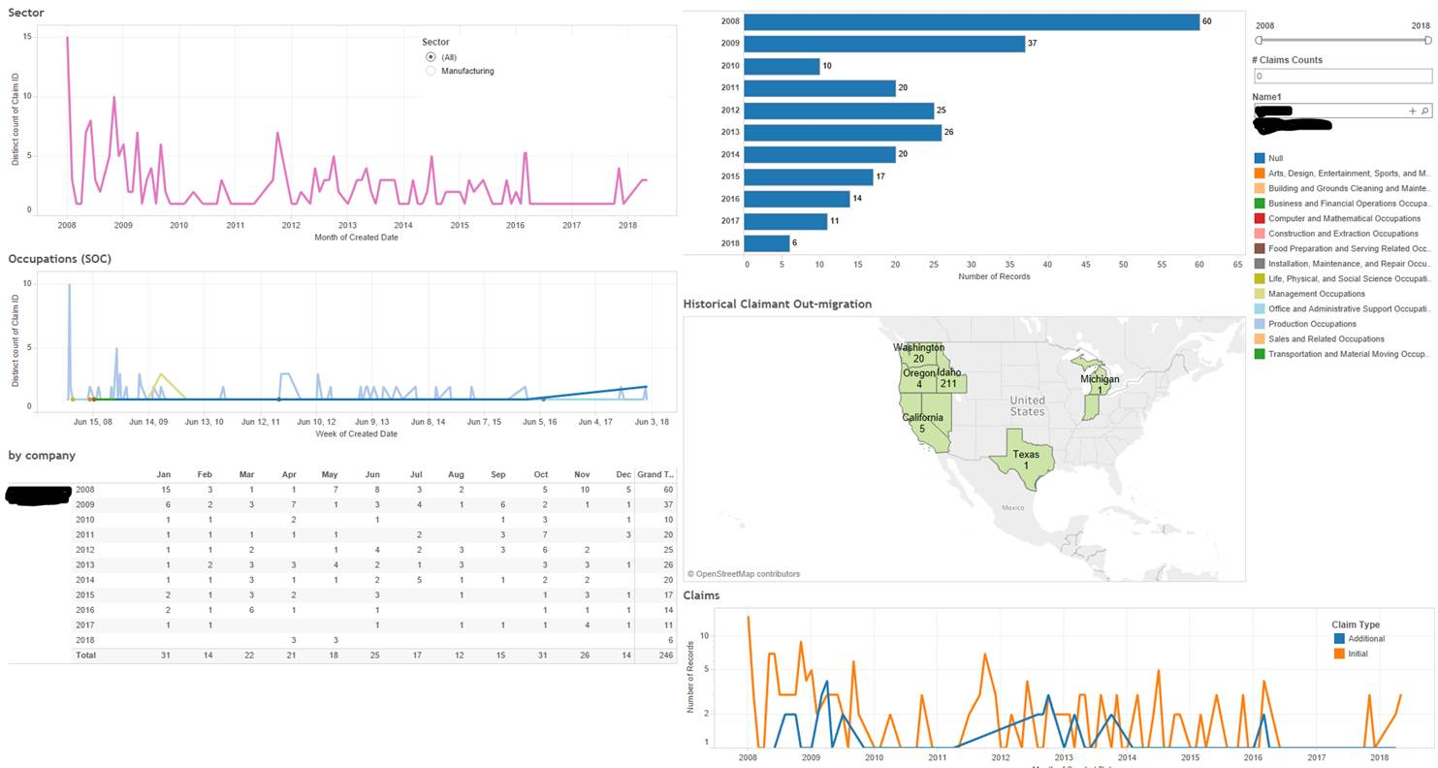
Layoff Activity by Company

Slide 3
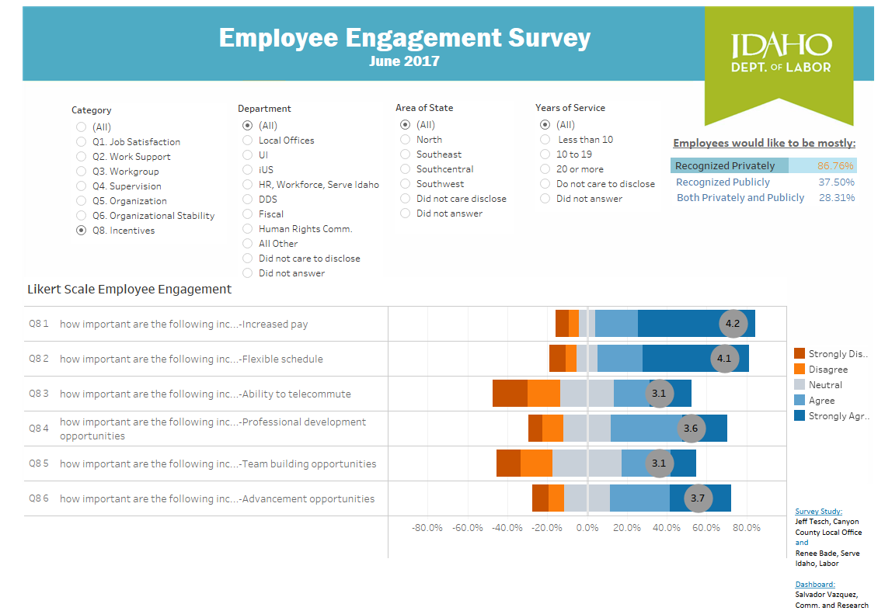
Idaho’s Rural-Urban Divide
Population Growth by Age and Rurality

Slide 4
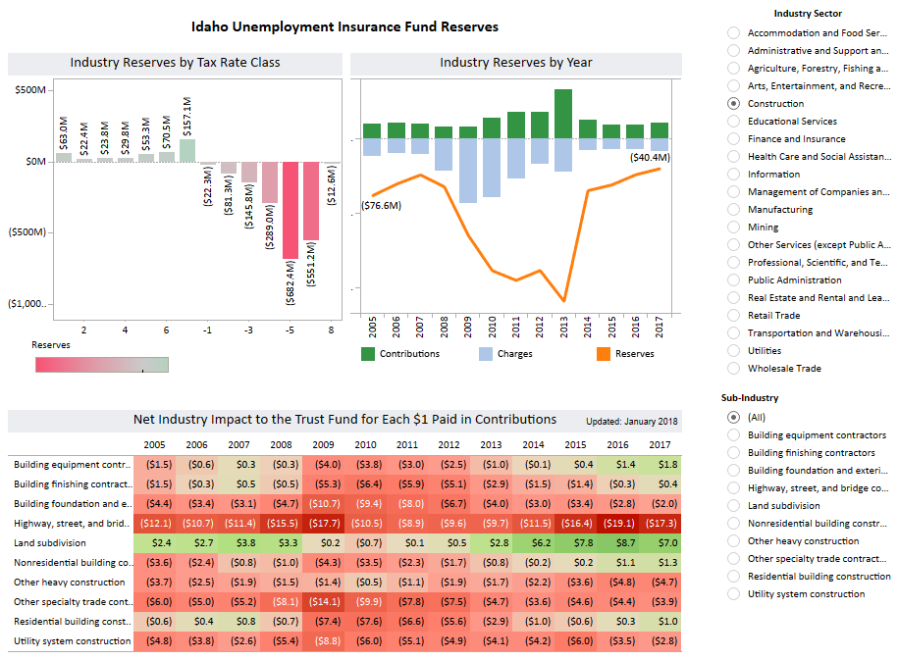
Trust Fund Historical Perspective

Slide 5
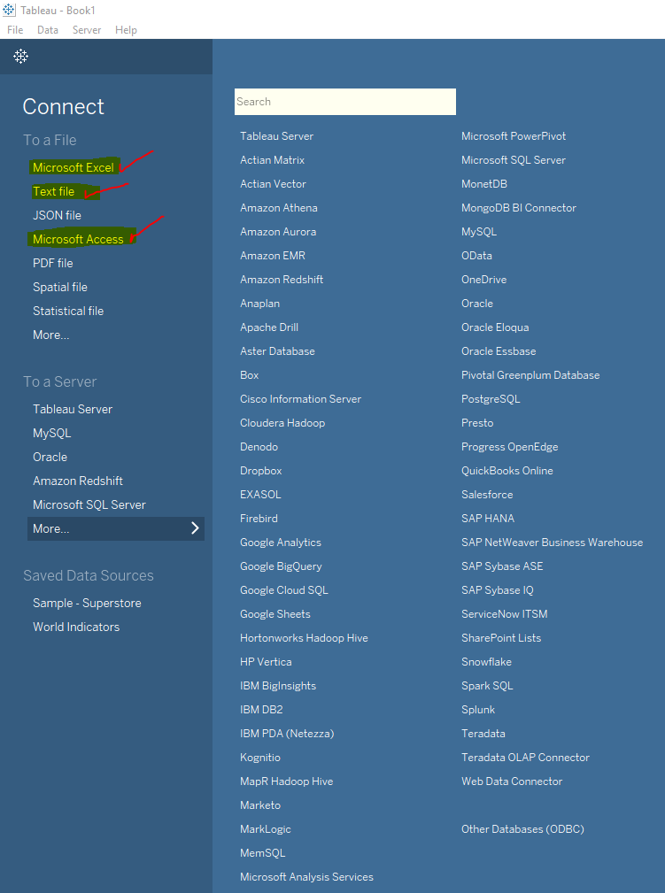
Software Options
Free Software
Free Version ≈ Desktop Version
Desktop Version
One time $2,000
Annual $200/Yr
Server Version
One time $50,000 (Minimum 20 Licenses)
Annual $4,000/Yr

Slide 6
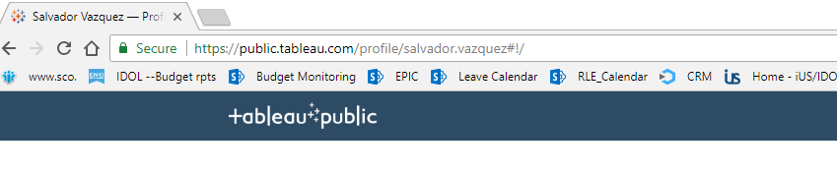
Deployment
Free vs Desktop vs Server Versions
Free & Desktop Versions Deploy at Tableau.com
-- Public Consumption
-- Everything published to the web gets processed at Tableau.com (1GB per user name)
Server Version Deploys internally, within Firewall
-- Exclusively for internal sharing and confidential visualizations
-- With a server version you must also own at least one Desktop license

Slide 7

Thank You
salvador.vazquez@labor.idaho.gov
208-332-3570 ext. 3201

