Slide 1
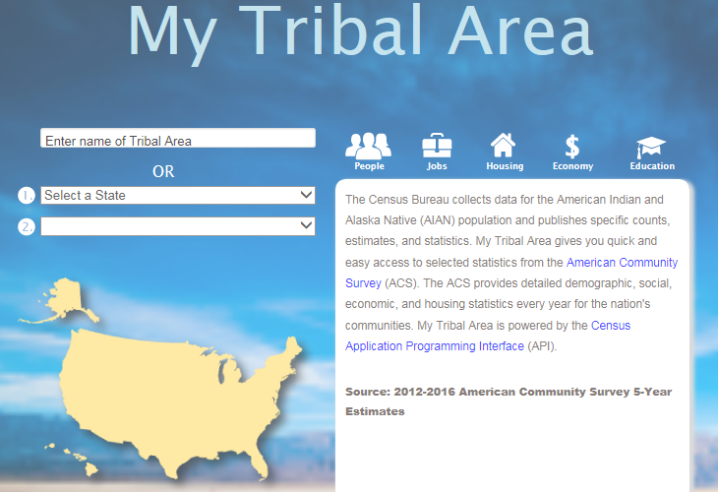
Using ACS for Tribal Demographic and Employment Data
www.census.gov/tribal

Slide 2
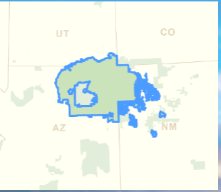
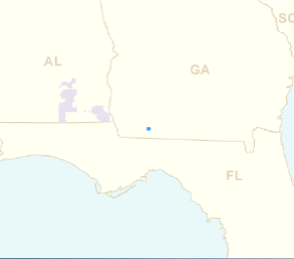
Using ACS for Tribal Demographic and Employment Data
Navajo Nation Reservation and Off-Reservation Trust Land
Tama (state) Reservation
Notes:
Crosses state lines

Slide 3
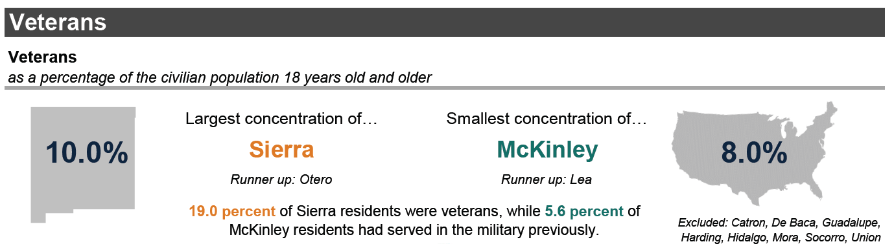
Using ACS for County-Level Data
We excluded these counties because margins of error >= 20 percent of the estimate
https://factfinder.census.gov/

Slide 4
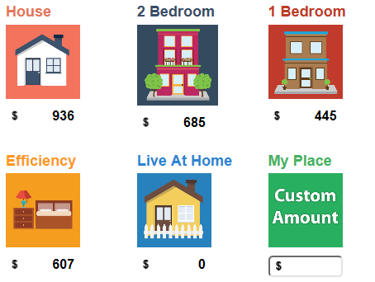
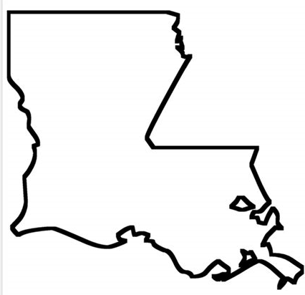
Using ACS for City-Level Data
Housing Costs in Roswell, New Mexico
From New Mexico’s Career Exploration Budgeting Tool, Why I Work
Thank you!
https://www.dws.state.nm.us/whyiwork/

Slide 5
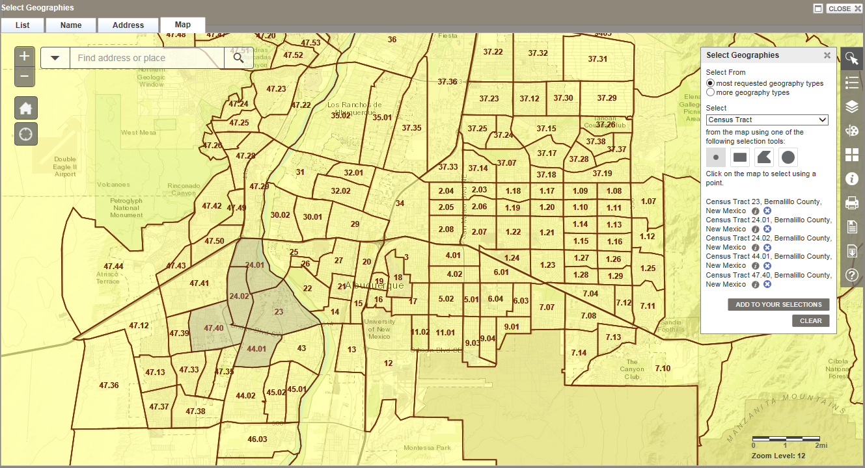
Using ACS for Census Tract Data
S1701 Poverty Status in the Past 12 Months: 2012-2016
https://factfinder.census.gov/
Notes:
26.9 percent

Slide 6
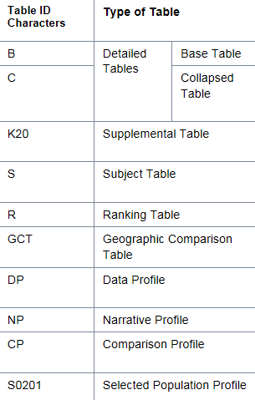
Important ACS Stuff to Remember
ACS Table Types
1-Year, 3-Year, or 5-Year?
The smaller the geography, the bigger the year
(i.e. use the 5 year)
Margin of Error
If too high may need to use a larger geography
https://factfinder.census.gov/

