Slide 1
Workforce Information Advisory Council
The “We-Ack”
May 2018
Mathew Barewicz
Vermont Department of Labor
Economic & Labor Market Information Chief
Labor Market Information online at VTLMI.info

Slide 2
Disclaimer
Presentations are intended for educational purposes only and do not replace independent professional judgment.
The information in this presentation was compiled from sources believed to be reliable for informational purposes only.
“The opinions expressed in this presentation and on the following slides are solely those of the presenter and not necessarily those of WIAC or USDOL. The WIAC or USDOL do not guarantee the accuracy or reliability of the information provided herein.”

Slide 3

The WIAC
Formed as part of the Workforce Innovation and Opportunity Act (“We-Oh-Ah”)
The purpose is to provide recommendations to the Secretary of Labor on:
  The evaluation and improvement of the nationwide workforce and labor market information system and statewide systems that comprise the nationwide system, and
  How the Department and the states will cooperate in the management of those systems. These systems include programs to produce employment-related statistics and state and local workforce and labor market information.
www.vtlmi.info

Slide 4
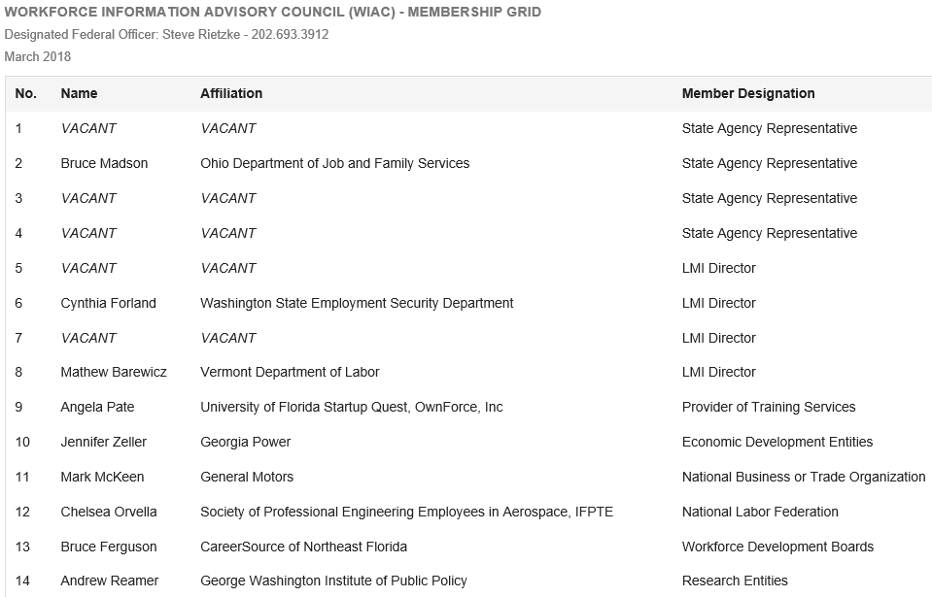
The Committee:
www.vtlmi.info

Slide 5
First Plug
Please consider applying for a vacant or expiring position
OR
Encourage someone you know to participate; just make sure they are a knowledgeable about LMI (“Elle-Em-Eye”)
www.vtlmi.info

Slide 6
The Work
Started in July 2016 and have since included
  4 in-person meetings
  4 virtual meetings
  Countless subcommittee meetings and conference calls
www.vtlmi.info

Slide 7
The Work
Work Product Produced to Date:
(Draft of) Final WIAC Report (short version)
(Draft of) WIAC Opportunities Infographic
- Highlighting 6 Opportunities
Second Draft of the Final WIAC Report (long version)
- Highlighting 9 Recommendations
www.vtlmi.info

Slide 8
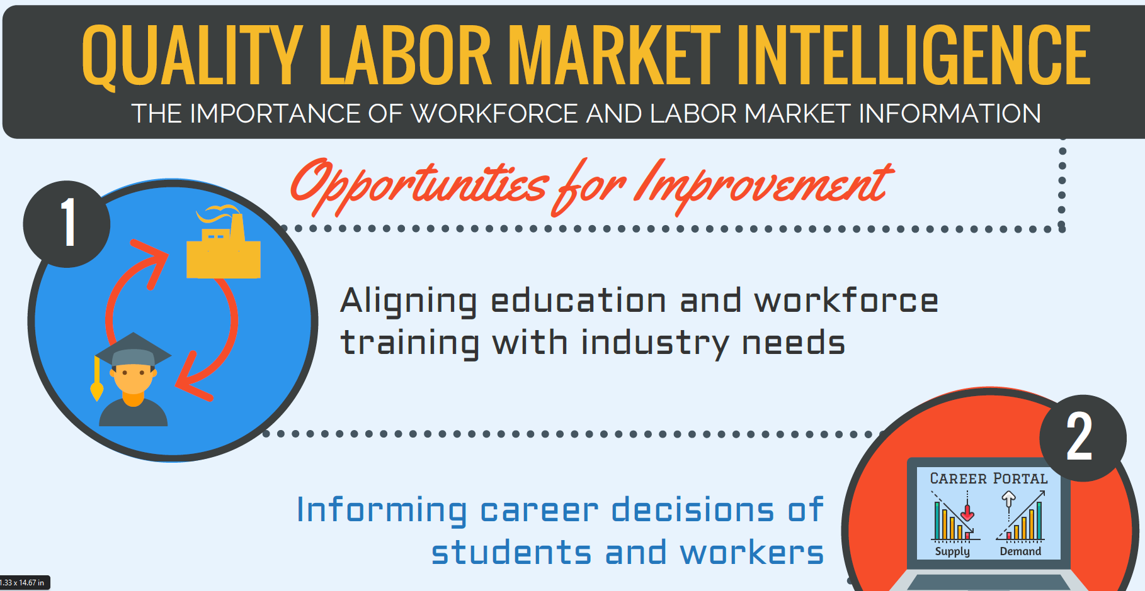

Slide 9
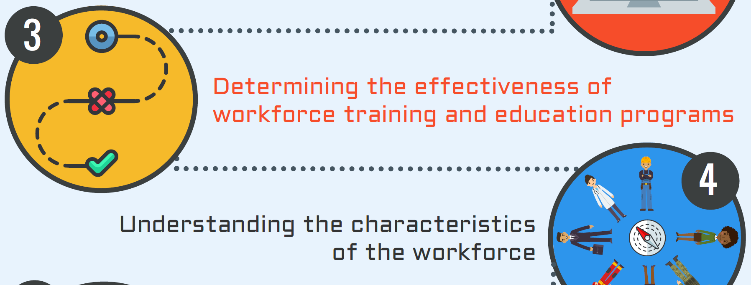

Slide 10
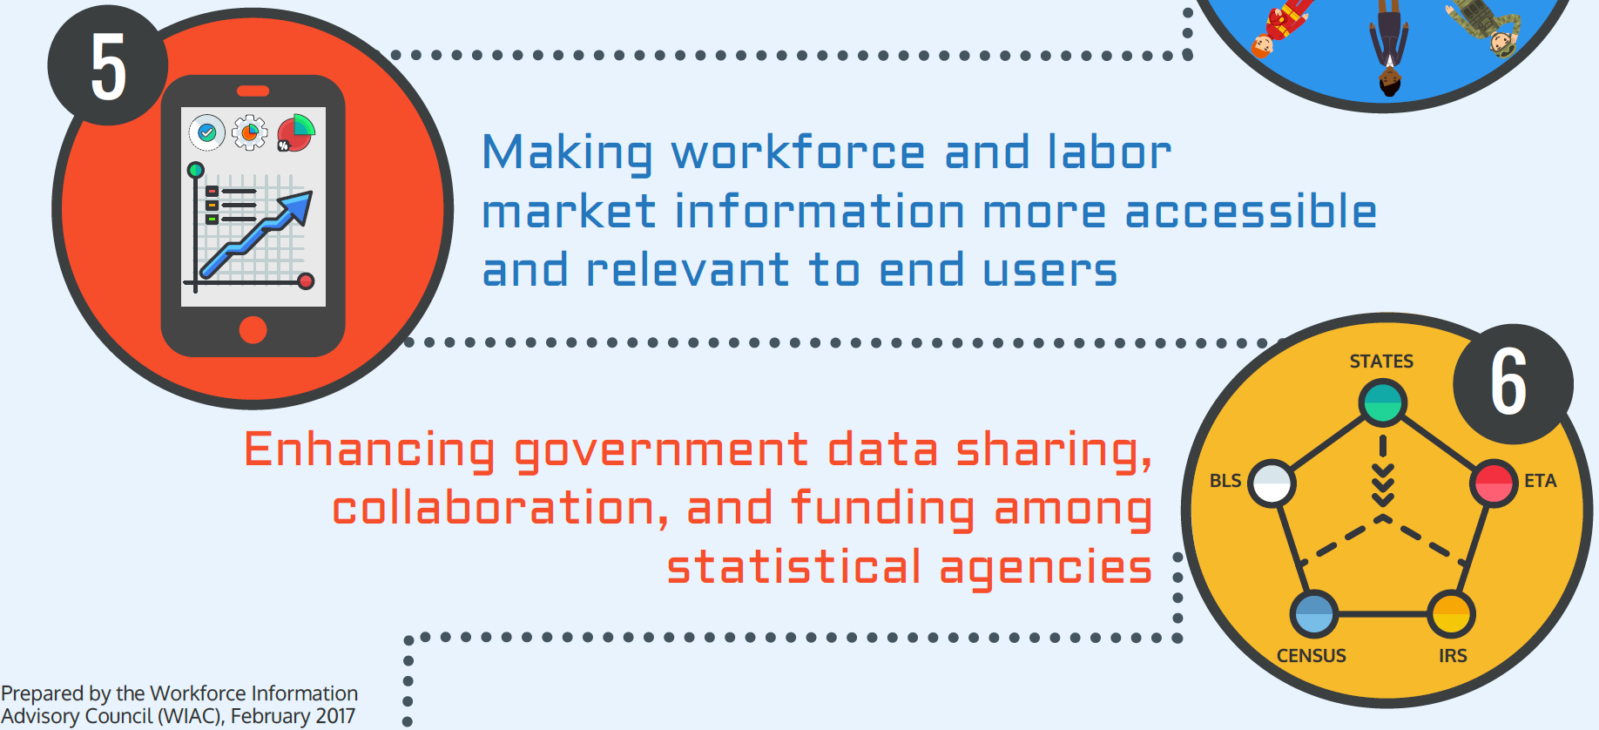

Slide 11
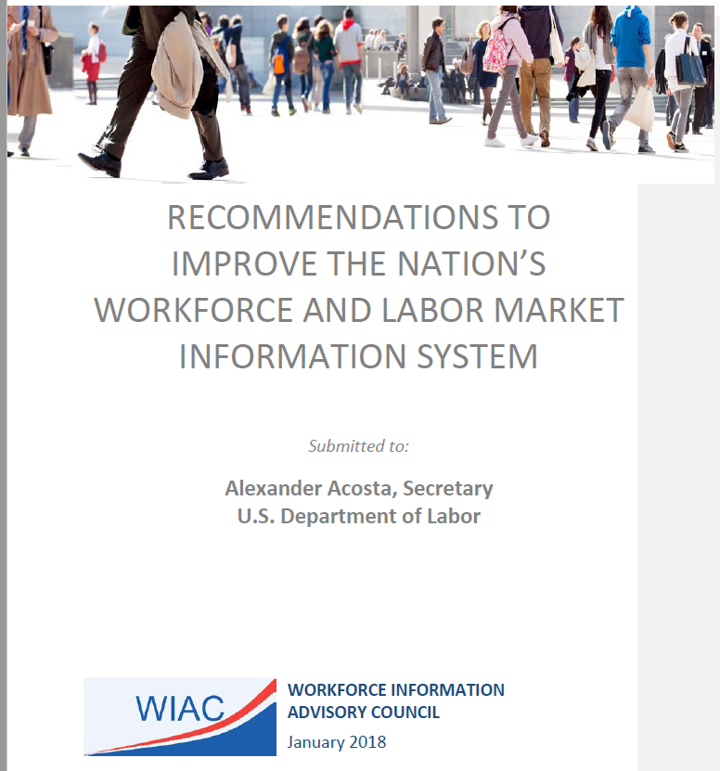
The Report:

Slide 12
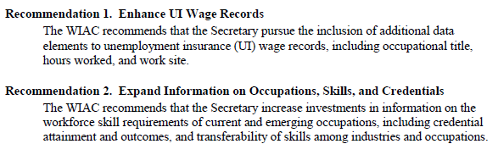
Recommendations on WLMI Products

Slide 13
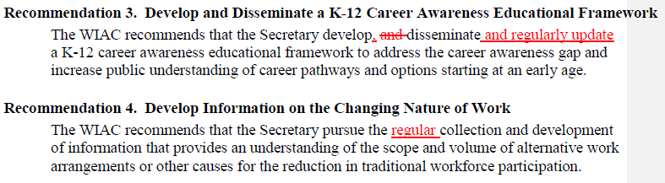
Recommendations on WLMI Products

Slide 14
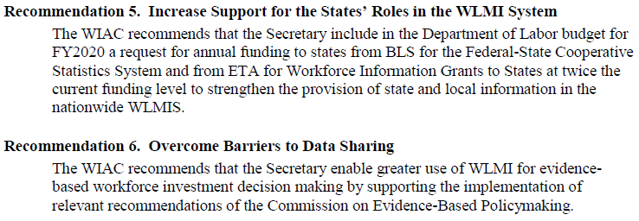
Recommendations on the WLMI System

Slide 15
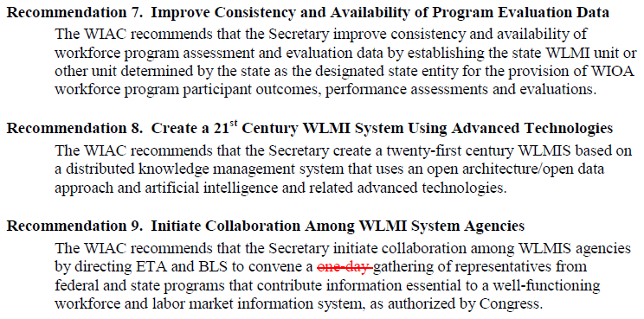
Recommendations on the WLMI System

Slide 16
Current Status
PENDING

Slide 17
Second Plug
Follow the work:
https://www.doleta.gov/wioa/wiac/
    (just google USDOL ETA WIAC)
Please provide feedback to a Council member
Because it is not the “Me-Ack”; it is the WE-Ack!
www.vtlmi.info

Slide 18
Questions???
& Thank you!
Slides prepared by: Mathew Barewicz
Economic & Labor Market Information Division
Vermont Department of Labor
802.828.4153
mathew.barewicz@vermont.gov
www.vtlmi.info

