Slide 1
Measuring Education - Workforce Alignment
An Alternative Approach
Steve Hine
May 22, 2018

Slide 2

Workforce Alignment System
Classification of Instructional Programs (CIP)
Count of Graduates Per Year
By Major And Degree Level
Standard Occupational Classification (SOC) System
Count of Occupational Job Openings Per Year
From Growth And Net Replacement
Converts CIP Annual Units (Graduates) Into
SOC Annual Units (Openings) And Vice versa

Slide 3
Necessary steps to construct the system
Measure annual number of grads by CIP and award entering the workforce
Measure award level required of occupational openings
Convert supply of graduates from instructional programs into occupational supply (or occupational demand into instructional program demand)
Measure annual number of occupational openings available to newly minted graduates of postsecondary programs of study

Slide 4
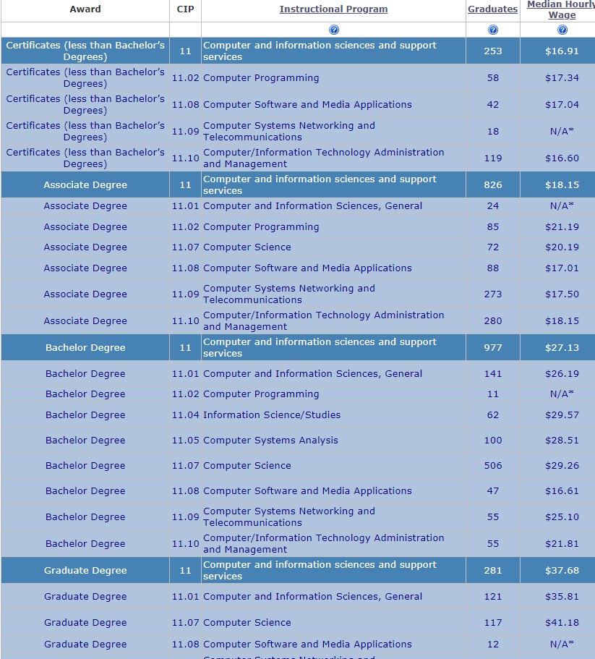
Measure annual number of grads by CIP and award entering the workforce
Data from WDQI/SLDS Database

Slide 5
Measure award level required of occupational openings
Concern over BLS classification being “too low”
Our Vacancy Survey asks “what educational level is usually required” for the vacant position?
We evaluated 31,701 employer responses reporting 727,860 vacancies in the state across 787 occupations between 2011:II and 2015:IV.
Number/Share of Occupations with Educational Requirements that Changed
Change in Requirement | Number of Occupations | Percent of Occupations | Total Employment in MN | Percent of Employment in MN
No Change | 700 | 85.4% | 2,303,940 | 87.3%
Decrease | 55 | 6.7% | 243,720 | 9.2%
Increase | 24 | 2.9% | 90,380 | 3.4%
N/A | 41 | 5.0% | 102,360 | 3.9%
Total | 820 | 95.0% | 2,638,040 | 100.0%
Source: Last two columns from Minnesota Occupational Employment Statistics, Q2 2015

Slide 6
Convert supply of graduates from instructional programs into occupational supply
Role of the CIP/SOC Crosswalk, but we made some adjustments
We used ACS data to identify frequent CIP to SOC transitions by 25-34 year olds to supplement the crosswalk to include ‘empirically significant’ transitions where they occur
Also included award level
Example -
01.0103 | Agricultural Economics | 19-3011 | Economists
 |  | 25-1041 | Agricultural Sciences Teachers, Postsecondary
 |  | 25-1063 | Economics Teachers, Postsecondary
Current ‘standard’
Our adjusted crosswalk
01.0103 | Bachelors Degree in Agricultural Economics | 19-3011 | Economists
 |  | 25-1041 | Accountants and Auditors
70% of BA Ag Econ grads take jobs as accountants/auditors
Distinguishes BA from Grad
01.0103 | Graduate Degree in Agricultural Economics | 19-3011 | Economists
 |  | 25-1041 | Agricultural Sciences Teachers, Postsecondary
 |  | 25-1063 | Economics Teachers, Postsecondary

Slide 7
Measure annual number of occupational openings available to newly minted graduates of postsecondary programs of study
Separations estimates outflows from an occupation, but career ‘pathways’ and advantage of experience suggest that many separations will be filled by incumbent workers => not available to new grads
Need to estimate inter-occupational inflows as well as outflows
Separations only count outflows that occur when a person takes another job in a different major occupational group – but 70% of inter-occupational transfers occur within a MOG
Need to account for all occupational transitions, including those within MOGs that are often steps up the career ladder

Slide 8
Net Replacements = Outflow from Occupation – Inflow into Occupation
Occupation X₂
Unemployed or Out of the Labor Force
Occupation Z₁
(Different MOG)
Occupation X₁
Occupation Y
Projections Separations estimate flows in RED, we want to estimate all flows
Unemployed or Out of the Labor Force, Including Those in School
Occupation Z₂
(Same MOG)

Slide 9
How to measure these flows
The CPS Annual Social and Economic Supplement (ASES) conducted each March asks about current and last year’s occupational employment
We used 5 years (2013-2017) of national level data to estimate occupational transition rates between each pair of occupations
Then applied these rates to Minnesota’s occupational employment distribution to estimate the number of individuals transitioning between each occupational pair
The result is a huge block-diagonal matrix ...

Slide 10
Small slice of this matrix highlighting Computer Occupations

Slide 11
Aggregating flows into/out of each occupation yields
 | Employment |  |  | Occupational Transfers |  | Into/Out of Employment
Occupation | Last Year | This Year | Growth | Out | In | Out | In
Computer research scientists | 355 | 362 | 7 | 104 | 96 | 22 | 37
Computer systems analysts | 15,893 | 16,202 | 309 | 1,686 | 1,648 | 746 | 1,092
Information security analysts | 3,786 | 3,838 | 52 | 545 | 531 | 160 | 226
Computer programmers | 7,255 | 7,229 | (26) | 812 | 1,016 | 493 | 264
Software developers | 24,081 | 24,345 | 264 | 1,787 | 1,633 | 908 | 1,326
Web developers | 3,275 | 3,331 | 56 | 499 | 470 | 255 | 340
Computer support specialists | 16,881 | 17,095 | 214 | 1,847 | 1,866 | 1,228 | 1,423
Database administrators | 2,469 | 2,495 | 26 | 477 | 433 | 74 | 144
Network administrators | 9,540 | 9,633 | 93 | 1,070 | 864 | 332 | 631
Computer network architects | 5,287 | 5,333 | 46 | 511 | 502 | 95 | 149
Computer occupations, all other | 7,040 | 7,106 | 66 | 912 | 1,353 | 711 | 335

Slide 12
Unemployed or Out of the Labor Force
Illustrative Example
908
1,787
Destination Occupations
Source Occupations
1,633
Software Developers
(Annual Growth = 264)
BLS Separations estimates:
337 LF Exits
+ 1,180 Occupational Transfers
= 1,517 Total Separations
1,326
Unemployed or Out of the Labor Force, Including Those in School

Slide 13
Some preliminary observations
Not surprisingly, we see many more ‘separations’ from most occupations than we do in Projections data
But accounting for occupational in-flows by incumbent workers tends to reduce openings available to newly minted graduates
Need to account for re-entrants into the labor force that are not out due to schooling, and account for those that are working and in school simultaneously
This work also provides empirical identification of common ‘career ladders’
Final product and technical documentation are expected by the end of summer

